Slide 1
Cloud Computing – CS3
Notes:
RL 3.3

Slide 2

Agenda
Virtualization Recap
Virtualization Approaches
Motivations
Full Virtualization
Para Virtualization
Hardware Assisted Virtualization
Compare & Contrast architectures
X86 Hardware Virtualization
Motivation & Challenges
X86 Hardware Virtualization
NFV - VNF
Notes:
Virtualization Recap
Virtualization is a technology that allows multiple operating systems and applications to run on a single physical machine by abstracting the hardware into multiple virtual machines (VMs). Each VM functions as a fully independent computer, with its own operating system and applications, while sharing the underlying physical hardware. This technology optimizes resource use, improves scalability, enhances disaster recovery, and provides better isolation and security.
Virtualization Approaches
Full Virtualization:
Description: Full virtualization provides complete abstraction of the underlying hardware. The guest OS operates without any modification, unaware that it’s running in a virtual environment.
Mechanism: The hypervisor manages all hardware access, translating guest OS requests into actions on the physical hardware.
Use Case: Suitable for environments where guests cannot be modified, such as running legacy operating systems.
Paravirtualization:
Description: In paravirtualization, the guest OS is modified to be aware of the virtualization layer, allowing it to interact more efficiently with the hypervisor.
Mechanism: The modified guest OS uses hypercalls to communicate with the hypervisor, reducing the overhead associated with hardware emulation.
Use Case: Best suited for environments where high performance is critical, and the OS can be modified.
Hardware-Assisted Virtualization:
Description: Modern CPUs provide direct support for virtualization through extensions like Intel VT-x and AMD-V, enabling more efficient and secure virtualization.
Mechanism: The hypervisor runs in a special mode (e.g., Ring -1) provided by the CPU, which allows it to manage VMs with minimal overhead.
Use Case: Used in environments requiring high performance and security, leveraging the latest hardware features.
Motivations for Virtualization
Resource Optimization: Consolidating multiple workloads on a single physical machine to optimize CPU, memory, and storage usage.
Cost Savings: Reducing the need for physical hardware, power, and cooling, leading to lower capital and operational expenditures.
Scalability and Flexibility: Easily scaling resources up or down and deploying new applications without purchasing additional hardware.
Disaster Recovery and Business Continuity: Facilitating quick recovery through VM backups, snapshots, and replication.
Improved Security and Isolation: Ensuring strong isolation between different workloads, reducing the risk of interference or breaches.
Full Virtualization
Characteristics: Provides a complete virtual representation of the underlying hardware. The guest OS operates as if it has full control of the hardware.
Hypervisor Role: The hypervisor traps and emulates hardware instructions to maintain this illusion, which can introduce performance overhead.
Example: VMware ESXi, Microsoft Hyper-V (in full virtualization mode).
Para Virtualization
Characteristics: Requires the guest OS to be modified to interact directly with the hypervisor. This reduces the need for emulation, leading to better performance.
Hypervisor Role: The hypervisor works more efficiently by avoiding the overhead of trapping and emulating every hardware access.
Example: Xen (in paravirtualized mode).
Hardware-Assisted Virtualization
Characteristics: Utilizes CPU extensions (Intel VT-x, AMD-V) that provide hardware support for virtualization, reducing the complexity and overhead of managing virtual machines.
Hypervisor Role: The hypervisor leverages hardware features to manage VMs more efficiently and securely, often running in a privileged mode below Ring 0.
Example: KVM (Kernel-based Virtual Machine), VMware ESXi, Microsoft Hyper-V (with hardware assistance).
Compare & Contrast Architectures
Full Virtualization vs. Para Virtualization:
Performance: Para virtualization typically offers better performance due to reduced emulation overhead.
Guest OS Modification: Full virtualization doesn’t require guest OS modification, while para virtualization does.
Compatibility: Full virtualization is compatible with unmodified guest OSes, while para virtualization is limited to supported and modified systems.
Full Virtualization vs. Hardware-Assisted Virtualization:
Performance: Hardware-assisted virtualization generally provides better performance than full virtualization by reducing the need for software-based emulation.
Complexity: Full virtualization requires complex software mechanisms to emulate hardware, while hardware-assisted virtualization offloads this to the CPU.
Security: Hardware-assisted virtualization enhances security by isolating VMs at the hardware level.
Para Virtualization vs. Hardware-Assisted Virtualization:
Guest OS Requirement: Para virtualization requires guest OS modification, while hardware-assisted virtualization does not.
Performance: Hardware-assisted virtualization can offer similar or better performance than para virtualization, depending on the workload and hardware.
X86 Hardware Virtualization
Motivation & Challenges
Motivation:
To overcome the limitations of software-based virtualization approaches and improve the performance, security, and efficiency of virtualized environments.
To enable broader adoption of virtualization across different workloads, including those requiring high performance and strict isolation.
Challenges:
Handling privileged instructions and managing the transition between guest OSes and the hypervisor without significant performance penalties.
Providing secure isolation between VMs while minimizing the overhead introduced by the virtualization layer.
Compatibility with legacy software and operating systems that were not designed with virtualization in mind.
X86 Hardware Virtualization
Intel VT-x and AMD-V: These are the primary hardware extensions that enable efficient virtualization on x86 platforms by allowing the hypervisor to run in a more privileged mode (Ring -1) and manage guest operating systems directly.
EPT/NPT (Extended/Nested Page Tables): These technologies further improve performance by allowing the hypervisor to manage guest memory more efficiently, reducing the overhead associated with memory management.
NFV - VNF
Network Functions Virtualization (NFV):
Description: NFV is the concept of virtualizing network services traditionally run on proprietary hardware, such as routers, firewalls, and load balancers, by implementing them as software running on virtualized infrastructure.
Advantages: NFV allows for more flexible, scalable, and cost-effective network management. It reduces the dependency on specialized hardware and enables rapid deployment of network services.
Virtual Network Functions (VNF):
Description: VNFs are the individual software components that perform specific network functions in an NFV architecture, such as routing, firewalling, or intrusion detection.
Deployment: VNFs run on virtual machines or containers within a virtualized environment, providing the same functionality as their hardware counterparts but with added flexibility and scalability.
Conclusion
Virtualization is a powerful technology that underpins many modern IT infrastructures, offering benefits such as cost savings, improved resource utilization, and enhanced scalability. Different approaches to virtualization, including full virtualization, para virtualization, and hardware-assisted virtualization, cater to varying performance and compatibility needs. As the technology evolves, innovations like NFV and VNFs continue to expand virtualization's role, particularly in networking, making it a critical component of contemporary IT strategy.

Slide 3

Recap

Slide 4
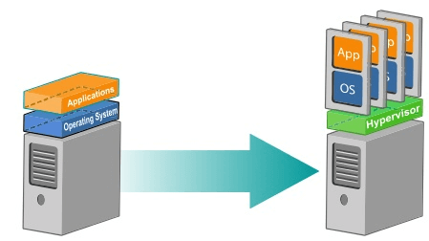
What is Virtualization?
Virtualization Defined
Key Terms:
VM ➔ Virtual Machine
VMM ➔ Virtual Machine Monitor
Hypervisor ➔ VMM
Multiplexed ➔ Many or several
Host ➔ System where the VMM resides
Guest ➔ Virtual Machines created
Virtualization is a computer architecture technology by which multiple virtual machines (VMs) are multiplexed in the same hardware machine.
Virtualization allows multiple operating system instances to run concurrently on a single computer
Instead of purchasing and maintaining an entire computer for one application, each application can be given its own operating system, and all those operating systems can reside on a single piece of hardware.
Virtualization allows an operator to control a guest operating system’s use of CPU, memory, storage, and other resources, so each guest receives only the resources that it needs.

Slide 5
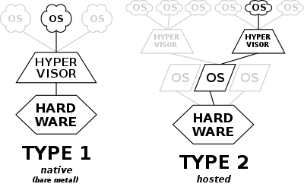
Understanding Hypervisor
Notes:
Image Credit : https://www.google.com/url?sa=i&url=https%3A%2F%2Fen.wikipedia.org%2Fwiki%2FHypervisor&psig=AOvVaw3piaHuLzIYLX-FwNgT-f-K&ust=1676014177158000&source=images&cd=vfe&ved=0CBEQjhxqFwoTCIC47b71h_0CFQAAAAAdAAAAABAE

Slide 6
What is Hypervisor
Hypervisor Demystified
A hypervisor is a form of virtualization software used in Cloud hosting to divide and allocate the resources on various pieces of hardware.
A hypervisor is a crucial piece of software that makes virtualization possible. It creates a virtualization layer that separates the actual hardware components - processors, RAM, and other physical resources - from the virtual machines and the operating systems they run.
Hypervisors emulate available resources so that guest machines can use them. No matter what operating system boots up on a virtual machine, it will think that actual physical hardware is at its disposal..
From a VM's standpoint, there is no difference between the physical and virtualized environment. Guest machines do not know that the hypervisor created them in a virtual environment or that they share available computing power.
Notes:
Source : https://www.techtarget.com/searchitoperations/definition/bare-metal-hypervisor
A hypervisor, also known as a virtual machine monitor (VMM), is software that creates and manages virtual machines (VMs) on a host system. It allows multiple operating systems to run simultaneously on a single physical machine by providing a layer of abstraction between the hardware and the operating systems.
There are two main types of hypervisors:
Type 1 (Bare-Metal) Hypervisor: Runs directly on the host's hardware and manages guest operating systems. Examples include VMware ESXi, Microsoft Hyper-V, and Xen.
Type 2 (Hosted) Hypervisor: Runs on a conventional operating system (OS) and relies on the host OS for operations. Examples include VMware Workstation and Oracle VirtualBox.
Hypervisors are essential for cloud computing, server virtualization, and efficient resource management in data centers.

Slide 7
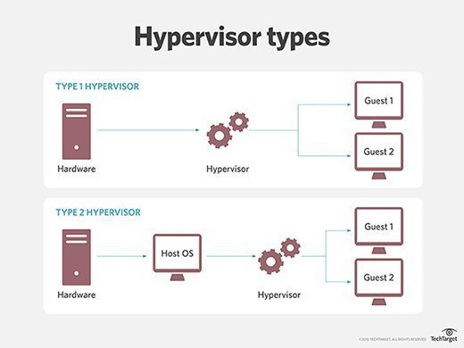
Why use Hypervisor
Why Use a Hypervisor?
VM’s can run as individual PC or computing resource.
Enable to create a larger resource pool
Maximize utilization of their computing resources.
Provide better IT mobility..
There are two types of hypervisors, according to their place in the server virtualization structure:
Type 1 Hypervisors, also known as bare-metal or native.
Type 2 Hypervisors, also known as hosted hypervisors.
The sections below explain both types in greater detail.
Notes:
Source : https://www.techtarget.com/searchitoperations/definition/bare-metal-hypervisor
Hypervisors are used for several key reasons, particularly in environments that require efficient resource management, flexibility, and scalability. Here are the main benefits of using a hypervisor:
Resource Optimization: Hypervisors allow multiple virtual machines (VMs) to share the same physical resources (CPU, memory, storage), optimizing the use of hardware and reducing costs.
Isolation and Security: Each VM runs in its own isolated environment, which enhances security. If one VM is compromised, it doesn't affect the others.
Flexibility and Scalability: Hypervisors make it easy to create, configure, and delete VMs, allowing businesses to quickly scale up or down based on demand.
Cost Savings: By running multiple VMs on a single physical server, organizations can reduce the need for additional hardware, leading to significant cost savings on equipment and maintenance.
Testing and Development: Hypervisors allow developers to create and test multiple environments (e.g., different OS versions) without the need for multiple physical machines. This is especially useful for testing software in different configurations.
Disaster Recovery: Virtual machines can be easily backed up, replicated, and moved between different physical servers, facilitating disaster recovery and business continuity.
Load Balancing: Hypervisors can distribute workloads across multiple VMs, balancing the load and ensuring optimal performance of applications.
Efficient Management: Hypervisors enable centralized management of virtual environments, simplifying tasks such as updates, patches, and monitoring.
Overall, hypervisors provide a versatile and powerful way to manage computing resources, making them essential in modern IT infrastructure, particularly in cloud computing and virtualization environments.

Slide 8
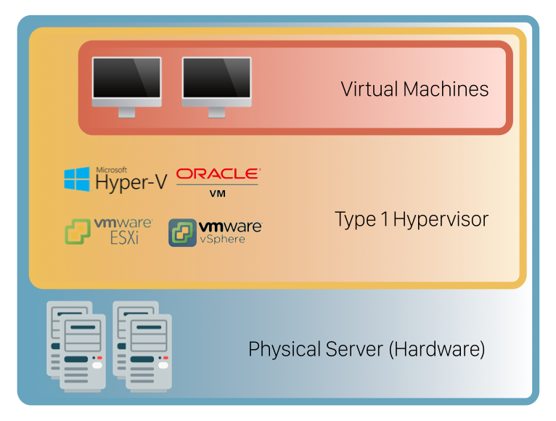
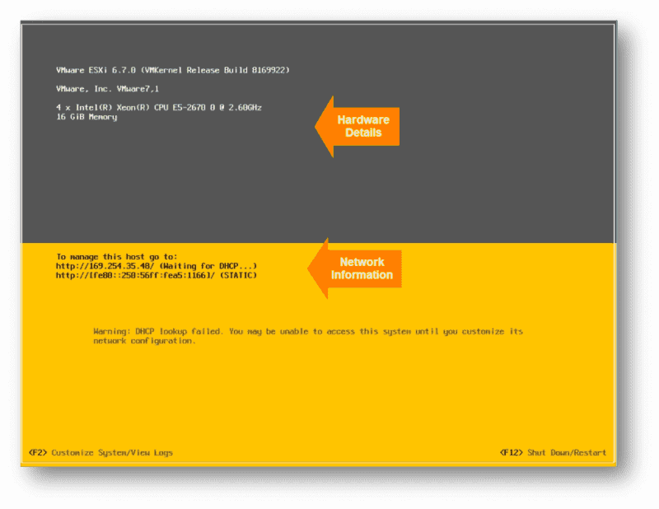
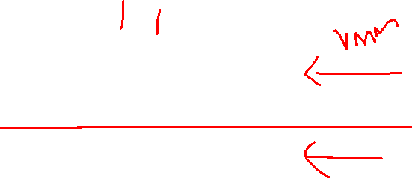
Type 1 Hypervisor
A Type 1 hypervisor is a layer of software installed directly on top of a physical server and its underlying hardware. Since no other software runs between the hardware and the hypervisor, it is also called the bare-metal hypervisor.
This hypervisor type provides excellent performance and stability since it does not run inside Windows or any other operating system. Instead, it is a simple operating system designed to run virtual machines. The physical machine the hypervisor runs on serves virtualization purposes only.
Type 1 hypervisors are mainly found in enterprise environments.
Notes:
Source : https://www.techtarget.com/searchitoperations/definition/bare-metal-hypervisor
A Type 1 hypervisor, also known as a bare-metal hypervisor, runs directly on the host's physical hardware, without relying on a traditional operating system. Because it operates at the hardware level, a Type 1 hypervisor is highly efficient, offering better performance, security, and scalability than its Type 2 counterpart.
Key Features of Type 1 Hypervisors:
Direct Hardware Access: Type 1 hypervisors communicate directly with the physical hardware, bypassing the need for an underlying operating system. This results in lower overhead and better performance.
High Security: Because there is no underlying operating system, there is a reduced attack surface, making Type 1 hypervisors more secure. The isolation between virtual machines (VMs) further enhances security.
Resource Management: These hypervisors efficiently allocate physical resources (CPU, memory, storage) to VMs, ensuring optimal utilization and performance.
Scalability: Type 1 hypervisors are well-suited for large-scale environments, such as data centers and cloud infrastructures, where multiple VMs need to be managed across multiple physical servers.
Reliability: Designed for continuous operation, Type 1 hypervisors are often used in mission-critical environments where high availability and reliability are essential.
Examples of Type 1 Hypervisors:
VMware ESXi: A popular enterprise-grade hypervisor used widely in data centers and for server virtualization.
Microsoft Hyper-V: Integrated into Windows Server, Hyper-V is a robust Type 1 hypervisor used for both on-premises and cloud deployments.
Xen: An open-source hypervisor used in cloud platforms like Amazon Web Services (AWS).
KVM (Kernel-based Virtual Machine): A Linux-based hypervisor that turns the Linux kernel into a bare-metal hypervisor, widely used in open-source environments.
Use Cases:
Enterprise Virtualization: Type 1 hypervisors are commonly used in enterprise environments to run multiple virtual servers on a single physical server, optimizing resource use.
Cloud Computing: They are a fundamental component of cloud infrastructures, enabling the creation and management of scalable, multi-tenant environments.
Data Centers: Type 1 hypervisors power large-scale data centers, offering high performance and reliability for critical applications.
Overall, Type 1 hypervisors are ideal for environments that demand high performance, security, and scalability.

Slide 9
Type 1 Hypervisor – Pros
VM Mobility - Type 1 hypervisors enable moving virtual machines between physical servers, manually or automatically. This move is based on the resource needs of a VM at a given moment and happens without any impact on the end-users. In case of a hardware failure, management software moves virtual machines to a working server as soon as an issue arises. The detection and restoration procedure takes place automatically and seamlessly.
Security - The type 1 hypervisor has direct access to hardware without an additional OS layer. This direct connection significantly decreases the attack surface for potential malicious actors.
Resource Over-Allocation - With type 1 hypervisors, you can assign more resources to your virtual machines than you have. For example, if you have 128GB of RAM on your server and eight virtual machines, you can assign 24GB of RAM to each. This totals 192GB of RAM, but VMs themselves will not consume all 24GB from the physical server. The VMs detect they have 24GB when they only use the amount of RAM they need to perform particular tasks.
Notes:
Source : https://www.techtarget.com/searchitoperations/definition/bare-metal-hypervisor
Type 1 hypervisors, also known as bare-metal hypervisors, offer several advantages due to their direct interaction with hardware. Here are the key pros:
1. High Performance:
Direct Hardware Access: Since Type 1 hypervisors run directly on the host's hardware without an underlying operating system, they can efficiently allocate resources and provide better performance for virtual machines (VMs).
2. Enhanced Security:
Isolation: VMs are isolated from each other, which reduces the risk of security breaches spreading between them.
Smaller Attack Surface: With no underlying OS, there’s a reduced attack surface compared to Type 2 hypervisors, making Type 1 more secure.
3. Scalability:
Enterprise-Grade Scalability: Type 1 hypervisors are designed to manage large numbers of VMs across multiple physical servers, making them ideal for data centers and cloud environments.
4. Reliability and Stability:
Purpose-Built for Virtualization: These hypervisors are engineered for continuous operation, offering high reliability and uptime, which is critical for mission-critical applications.
5. Efficient Resource Management:
Optimized Resource Allocation: Type 1 hypervisors excel at allocating CPU, memory, and storage resources efficiently, leading to better overall system performance and lower overhead.
6. Support for Advanced Features:
Advanced Capabilities: They support advanced virtualization features like live migration, high availability, and load balancing, which are crucial for maintaining a robust virtual environment.
7. Better Suitability for Enterprise Use:
Enterprise-Level Support: Type 1 hypervisors typically come with robust vendor support, including regular updates, patches, and enterprise-grade features.
8. Customizability:
Tailored Environments: Type 1 hypervisors allow for extensive customization of the virtual environment, enabling fine-tuned configurations that match specific business needs.
9. Energy Efficiency:
Reduced Hardware Requirements: By consolidating multiple VMs on a single physical server, organizations can reduce the number of physical servers required, leading to lower energy consumption and operational costs.
Overall, Type 1 hypervisors are ideal for environments that require high performance, scalability, and security, making them a preferred choice for enterprise virtualization, data centers, and cloud infrastructures.

Slide 10
Type 1 Hypervisor – Cons
Cons
Limited functionality - Type 1 hypervisors are relatively simple and do not offer many features. The functionalities include basic operations such as changing the date and time, IP address, password, etc.
Complicated management - To create virtual instances, you need a management console set up on another machine. Using the console, you can connect to the hypervisor on the server and manage your virtual environment.
Price - Depending on what functionalities you need, the license cost for management consoles varies substantially.
Notes:
Source : https ://www.techtarget.com/searchitoperations/definition/bare-metal-hypervisor
While Type 1 hypervisors offer many advantages, they also come with some drawbacks. Here are the key cons:
1. Complexity:
Advanced Setup and Management: Implementing and managing a Type 1 hypervisor requires specialized knowledge and skills, making it more complex to set up and maintain compared to Type 2 hypervisors.
Steep Learning Curve: IT staff may need extensive training to effectively manage and troubleshoot Type 1 hypervisors, especially in large-scale environments.
2. Higher Cost:
Initial Investment: The cost of acquiring, implementing, and supporting a Type 1 hypervisor can be significant, particularly for enterprise-grade solutions like VMware ESXi or Microsoft Hyper-V.
Hardware Requirements: Type 1 hypervisors often require dedicated, high-performance hardware, which can increase capital expenditures.
3. Limited Hardware Compatibility:
Hardware Dependency: Since Type 1 hypervisors run directly on the physical hardware, they may have strict hardware compatibility requirements, limiting the choice of servers and components.
Vendor Lock-In: Some Type 1 hypervisors are tied to specific hardware vendors, potentially leading to vendor lock-in and reduced flexibility in hardware choices.
4. Reduced Flexibility for Small Deployments:
Overkill for Small-Scale Use: For small or simple virtual environments, a Type 1 hypervisor might be overkill, as the complexity and cost outweigh the benefits in such cases.
Difficulty in Ad-Hoc Changes: Making quick or ad-hoc changes to the virtual environment can be more cumbersome compared to a Type 2 hypervisor.
5. Maintenance and Downtime:
Potential for Downtime: Although Type 1 hypervisors are designed for high availability, maintenance tasks like updates or hardware upgrades may still require downtime, which can affect business continuity.
Dependency on Vendor Support: Reliance on vendor support for patches, updates, and troubleshooting can be a limitation, especially if the vendor's response time is slow.
6. Licensing Costs:
Expensive Licensing Models: Many Type 1 hypervisors, especially enterprise-grade ones, come with costly licensing models, which can add to the total cost of ownership.
7. Limited Software Compatibility:
Compatibility Issues: Some software applications may not run optimally in a virtualized environment, or may require specific configurations that are more challenging to implement with a Type 1 hypervisor.
8. Resource Allocation Challenges:
Overhead and Resource Contention: In environments with numerous VMs, managing resource contention and overhead can become complex, requiring careful planning and monitoring to avoid performance degradation.
In summary, while Type 1 hypervisors are powerful tools for virtualization, their complexity, cost, and potential for downtime make them less suitable for small-scale deployments or environments where budget and flexibility are primary concerns. They are best suited for large enterprises and data centers where their advantages outweigh the drawbacks.

Slide 11
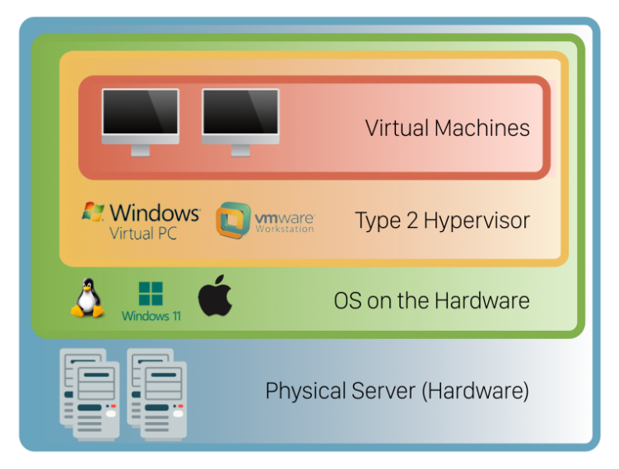
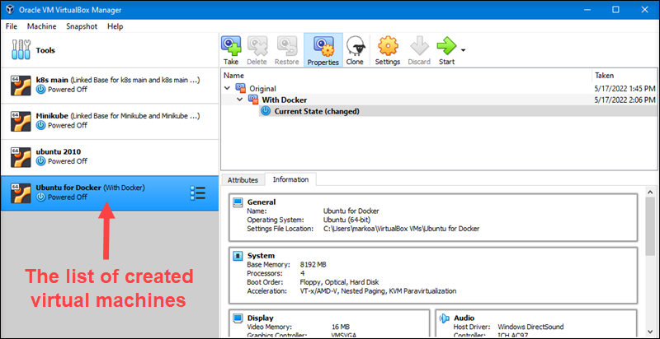
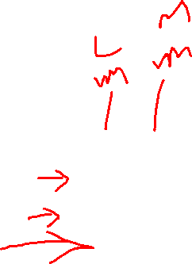
Type 2 Hypervisor
Type 2 hypervisors run inside the physical host machine's operating system, which is why they are called hosted hypervisors. Unlike bare-metal hypervisors that run directly on the hardware, hosted hypervisors have one software layer in between. The system with a hosted hypervisor contains:
A physical machine.
An operating system installed on the hardware (Windows, Linux, macOS).
A type 2 hypervisor software within that operating system.
Guest virtual machine instances.
Type 2 hypervisors are typically found in environments with a small number of servers.
What makes them convenient is that they do not need a management console on another system to set up and manage virtual machines. Everything is performed on the server with the hypervisor installed, and virtual machines launch in a standard OS window.
Hosted hypervisors also act as management consoles for virtual machines. Any task can be performed using the built-in functionalities. Below is one example of a type 2 hypervisor interface (VirtualBox by Oracle):
Notes:
Source : https://w ww.techtarget.com/searchitoperations/definition/bare-metal-hyperisor
A Type 2 hypervisor, also known as a hosted hypervisor, runs on top of a conventional operating system (OS) like Windows, Linux, or macOS. Unlike Type 1 hypervisors, which interact directly with the hardware, Type 2 hypervisors rely on the underlying host OS to manage hardware resources and provide virtualization services.
Key Features of Type 2 Hypervisors:
Ease of Installation:
Runs on Existing OS: Since Type 2 hypervisors are installed as applications on top of an existing OS, they are easier to set up and use, making them ideal for personal or small-scale virtualization.
User-Friendly:
Accessible Interface: They often come with a graphical user interface (GUI) that makes it simple for users to create and manage virtual machines (VMs) without needing extensive technical knowledge.
Flexibility:
Supports Multiple OS Types: Users can run different operating systems (e.g., Windows, Linux, macOS) as VMs on a single machine, which is useful for testing, development, and running applications that require different OS environments.
Lower Hardware Requirements:
Runs on Standard Hardware: Type 2 hypervisors can be installed on standard desktop or laptop hardware, without the need for specialized server equipment.
Examples of Type 2 Hypervisors:
VMware Workstation: A widely used Type 2 hypervisor for running multiple OS environments on a single machine, commonly used by developers and IT professionals.
Oracle VirtualBox: A free, open-source hypervisor that supports a wide range of host and guest operating systems, popular for personal and educational use.
Parallels Desktop: A Type 2 hypervisor designed for macOS users to run Windows and other operating systems alongside macOS.
Microsoft Hyper-V (Client): While Hyper-V is primarily a Type 1 hypervisor, it can also be used in a Type 2 configuration on Windows 10 and Windows 11 client machines.
Use Cases:
Software Development and Testing: Developers can use Type 2 hypervisors to test software on different OS versions without needing multiple physical machines.
Educational Purposes: Students and educators can run various operating systems and experiment with different environments on a single device.
Running Legacy Applications: Users can run older applications that require a different OS without needing to maintain separate hardware.
Personal Use: Type 2 hypervisors are popular for home users who want to explore different operating systems or run applications that are not compatible with their primary OS.
Advantages:
Easy to Use: Simple installation and user-friendly interfaces make Type 2 hypervisors accessible to a broad audience.
Flexibility: Users can quickly create and delete VMs, making it easy to experiment with different OS configurations.
Cost-Effective: Many Type 2 hypervisors are free or have low licensing costs, making them an economical choice for individuals and small businesses.
Disadvantages:
Lower Performance: Since they rely on the host OS for hardware management, Type 2 hypervisors generally offer lower performance compared to Type 1 hypervisors.
Resource Overhead: Running a hypervisor on top of an existing OS introduces additional overhead, which can affect the performance of both the host and the guest systems.
Security Concerns: Because they depend on the host OS, any vulnerabilities in the host OS can potentially affect the VMs running on the hypervisor.
Overall, Type 2 hypervisors are best suited for use cases where ease of use, flexibility, and low cost are more important than raw performance and scalability. They are ideal for individual users, developers, and small-scale environments where virtualization is needed without the complexity of managing a bare-metal hypervisor.

Slide 12
Type 2 Hypervisor - PROs
Pros
Easy to manage - There is no need to install separate software on another machine to create and maintain your virtual environment. Install and run a type 2 hypervisor as any other application within your OS. Create snapshots or clone your virtual machines, import or export appliances, etc.
Convenient for testing - Type 2 hypervisors are convenient for testing new software and research projects. It is possible to use one physical machine to run multiple instances with different operating systems to test how an application behaves in each environment or to create a specific network environment. You only need to ensure that there are enough physical resources to keep the host and virtual machines running.
Allows access to additional productivity tools - The users of type 2 hypervisors can use the tools available on other operating systems alongside their primary OS. For example, Windows users can access Linux applications by creating a Linux virtual machine.
Notes:
Type 2 hypervisors offer several advantages, particularly for users who need an easy-to-use and flexible virtualization solution. Here are the key pros:
1. Ease of Installation and Use:
Runs on Existing Operating Systems: Type 2 hypervisors can be installed like any other software application on top of a conventional operating system (e.g., Windows, macOS, Linux), making them easy to set up and use without requiring advanced technical knowledge.
User-Friendly Interface: Many Type 2 hypervisors come with intuitive graphical user interfaces (GUIs), making it simple to create, manage, and configure virtual machines (VMs).
2. Flexibility:
Supports Multiple Operating Systems: Users can run different operating systems (e.g., Windows, Linux, macOS) on the same physical machine, enabling the testing and use of software that requires different environments.
Quick VM Creation and Deletion: Type 2 hypervisors allow users to quickly create and delete VMs, making it easy to experiment with different setups or configurations.
3. Lower Hardware Requirements:
No Need for Specialized Hardware: Type 2 hypervisors can run on standard desktop or laptop hardware, eliminating the need for expensive, dedicated server equipment.
Runs on Personal Devices: These hypervisors are suitable for personal computers, making them accessible to a wide range of users, including developers, students, and hobbyists.
4. Cost-Effective:
Free and Low-Cost Options: Many Type 2 hypervisors, such as Oracle VirtualBox, are free to use, while others like VMware Workstation offer affordable licensing options, making them an economical choice for individuals and small businesses.
No Additional Licensing Costs: Since they run on top of existing operating systems, there are typically no additional licensing costs for the underlying OS.
5. Ideal for Development and Testing:
Software Development: Developers can use Type 2 hypervisors to test applications across different operating systems without needing multiple physical machines.
Cross-Platform Testing: Type 2 hypervisors allow developers to easily test their software on various OS versions and configurations, ensuring broader compatibility.
6. Support for Legacy Applications:
Running Older Software: Users can run older or legacy applications that are no longer compatible with modern operating systems by creating a VM with the required older OS version.
7. Convenient for Educational and Training Purposes:
Learning and Experimentation: Students, educators, and IT professionals can use Type 2 hypervisors to explore different operating systems, configurations, and software in a controlled and isolated environment without affecting the host system.
8. No Need for Dual Booting:
Multiple OSes Simultaneously: Instead of setting up a dual-boot system, which requires restarting the computer to switch between operating systems, Type 2 hypervisors allow users to run multiple OSes simultaneously, providing greater convenience.
9. Low Risk to Host System:
Isolated Environment: VMs run in isolated environments, meaning that if something goes wrong within a VM (e.g., malware infection), it doesn’t directly affect the host OS, reducing the risk to the primary system.
10. Ease of Backup and Recovery:
Snapshot and Restore: Many Type 2 hypervisors support snapshots, allowing users to take a snapshot of a VM’s state and restore it if needed, which is helpful for testing and development scenarios.
Overall, Type 2 hypervisors are a flexible, user-friendly, and cost-effective option for virtualization, making them a popular choice for individuals, developers, educators, and small businesses. They are ideal for environments where simplicity and convenience are prioritized over maximum performance and scalability.

Slide 13
Type 2 Hypervisor - CONs
Cons
Less flexible resource management - Allocating resources with this type of hypervisor is more difficult than with type 1. Bare-metal hypervisors can dynamically allocate available resources depending on the current needs of a particular VM. A type 2 hypervisor occupies whatever the user allocates to a virtual machine. When a user assigns 8GB of RAM to a VM, that amount will be taken up even if the VM is using only a fraction of it. If the host machine has 32GB of RAM and the user creates three VMs with 8GB each, they are left with 8GB of RAM to keep the physical machine running. Creating another VM with 8GB of ram would bring down the system.
Performance - The host OS creates additional pressure on physical hardware, which may result in VMs having latency issues.
Security - Type 2 hypervisors run on top of an operating system. This fact introduces a potential vulnerability since attackers may use potential vulnerabilities of the OS to gain access to virtual machines
Notes:
While Type 2 hypervisors offer many benefits, they also have some drawbacks. Here are the key cons:
1. Lower Performance:
Indirect Hardware Access: Type 2 hypervisors run on top of a host operating system, which adds an extra layer of abstraction between the virtual machines (VMs) and the hardware. This can result in slower performance compared to Type 1 hypervisors, which interact directly with the hardware.
Increased Overhead: The additional layer of the host OS can introduce overhead, reducing the efficiency and speed of the VMs.
2. Resource Contention:
Shared Resources: Since the host operating system and the VMs share the same physical resources (CPU, memory, storage), resource contention can occur, leading to performance degradation, especially when running multiple VMs simultaneously.
Dependent on Host OS Performance: The performance of the VMs is directly tied to the performance of the host OS. If the host OS becomes slow or unstable, it can negatively impact all the VMs running on it.
3. Security Concerns:
Vulnerability to Host OS Issues: Type 2 hypervisors are dependent on the security and stability of the host OS. If the host OS is compromised or has vulnerabilities, the security of the VMs may also be at risk.
Less Isolation: Compared to Type 1 hypervisors, Type 2 hypervisors typically provide less isolation between VMs and the host system, increasing the risk of potential security breaches.
4. Limited Scalability:
Not Ideal for Large-Scale Deployments: Type 2 hypervisors are generally not suited for large-scale, enterprise-level deployments due to their performance limitations and reliance on the host OS.
Resource Limits: They are more suitable for small to medium-scale environments or individual use, where the demands on resources are lower.
5. Higher Dependency on Host OS:
Host OS Crashes Affect VMs: If the host operating system crashes or requires a reboot, all VMs running on the hypervisor will be affected, leading to downtime.
Updates and Patches: Regular updates and patches to the host OS can require reboots, which also disrupt the VMs running on the hypervisor.
6. Complexity in Resource Allocation:
Manual Management: Resource allocation (CPU, memory) often needs to be managed manually, which can be cumbersome and may lead to inefficient use of hardware resources if not properly configured.
7. Limited Advanced Features:
Fewer Enterprise-Grade Features: Compared to Type 1 hypervisors, Type 2 hypervisors may lack advanced features like live migration, high availability, and dynamic load balancing, which are important for enterprise environments.
8. Potential for Compatibility Issues:
Software Conflicts: Running a hypervisor on top of a host OS can sometimes lead to software conflicts, especially if the host OS is not fully compatible with the hypervisor or the guest OS.
Driver and Peripheral Issues: Since Type 2 hypervisors rely on the host OS for hardware drivers, there can be issues with peripheral support or driver compatibility.
9. Higher Maintenance Overhead:
Frequent Host OS Maintenance: The host OS requires regular maintenance (e.g., updates, patches, virus scans), which can add to the overall maintenance burden and affect the availability of the VMs.
10. Not Suitable for High-Performance Workloads:
Limited Suitability for Intensive Tasks: Type 2 hypervisors are generally not recommended for running high-performance, resource-intensive workloads, such as large databases, high-end simulations, or enterprise-level applications.
In summary, while Type 2 hypervisors are easy to use and flexible, their performance limitations, dependency on the host OS, and security concerns make them less suitable for large-scale or high-performance environments. They are better suited for personal use, development, testing, or small-scale virtualization needs.

Slide 14

Type 1 & 2 Hypervisor – At a Glance
⬅ Type 1 or Bare Metal is installed directly on hardware
Type 2 is installed on top of an existing OS ➔
⬅ Mostly used by Enterprise CSP
Mostly used by Medium & Medium Small scale enterprises ➔
⬅ Need to have a separate VM Management console to monitor the VM
Has an in-built console ➔
Notes:
Type 1 Hypervisor (Left Side)
Installation:
Type 1 hypervisors, also known as "Bare Metal" hypervisors, are installed directly on the physical hardware. There is no underlying operating system between the hardware and the hypervisor.
Usage:
Primarily used by enterprise cloud service providers (CSPs). These are ideal for large-scale deployments and enterprise environments where performance and scalability are crucial.
Management:
Type 1 hypervisors require a separate virtual machine (VM) management console to monitor and manage the VMs. This is because the hypervisor itself is minimalistic and does not include a full-fledged user interface.
Type 2 Hypervisor (Right Side)
Installation:
Type 2 hypervisors are installed on top of an existing operating system (OS). This OS is responsible for managing the hardware, while the hypervisor sits on top of it to manage virtual machines.
Usage:
Mostly used by medium and small-scale enterprises. These are more suited for environments where ease of use, flexibility, and lower cost are more important than performance and scalability.
Management:
Type 2 hypervisors typically come with an in-built console that allows users to create, manage, and monitor virtual machines directly from the host operating system. This makes them more user-friendly and accessible.

Slide 15
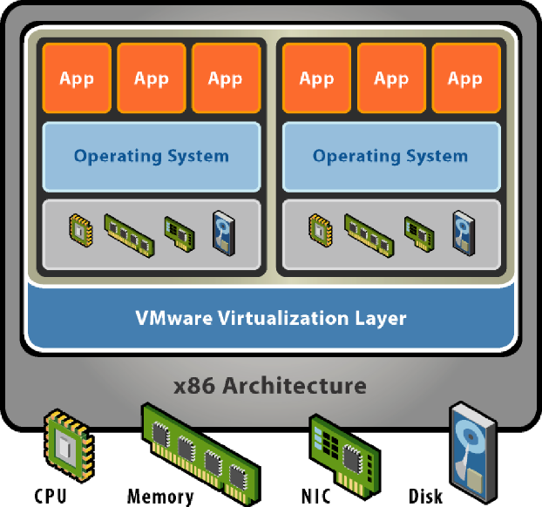
Virtualization Evolution

Slide 16
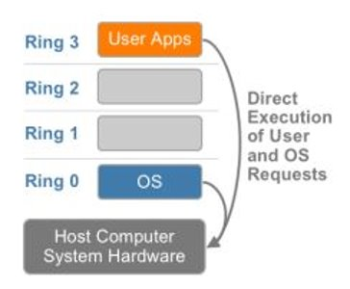
x86 Architecture
+------------------------------------+
| Application |
+------------------------------------+
| OS Kernel |
+------------------------------------+
| Hardware Abstraction |
+------------------------------------+
| Microarchitecture |
+------------------------------------+
| Physical Hardware |
+------------------------------------+
Notes:
Protection Rings:
Protection rings are a hierarchical model that defines levels of privilege in a computer system, which help to control access to the hardware resources. The rings range from Ring 0 to Ring 3, with Ring 0 having the highest level of privilege (closest to the hardware) and Ring 3 having the least.
Ring 0 (OS)
Level: Most privileged
Role: This ring is where the operating system (OS) kernel operates. The kernel has direct access to the system’s hardware and can execute all instructions and access all memory addresses.
Components: The OS kernel, which includes core functions like memory management, process management, and hardware communication.
Interaction: Direct execution of user and OS requests. This means that Ring 0 can execute commands that interact directly with the physical hardware.
Ring 1
Level: Less privileged than Ring 0
Role: This ring is typically used for drivers and other critical system software that require more privileges than regular applications but less than the OS kernel.
Components: Hardware abstraction layer (HAL), which mediates between the hardware and the OS kernel.
Ring 2
Level: Less privileged than Ring 1
Role: This ring is generally used for device drivers that do not require direct access to the hardware but still need more privilege than user applications.
Components: Additional hardware drivers and services.
Ring 3 (User Apps)
Level: Least privileged
Role: This is where user applications run. These applications have the least amount of privilege and cannot directly access hardware or execute privileged instructions.
Components: User-level applications such as word processors, web browsers, and other software that interacts with the OS through system calls.
Direct Execution of User and OS Requests:
The diagram shows how requests from user applications (Ring 3) and the OS (Ring 0) are executed. The OS in Ring 0 handles the most critical tasks and has direct access to the hardware. User applications in Ring 3 make requests to the OS, which then performs the necessary operations on the hardware.
System Hardware:
Host Computer System Hardware: This is the physical layer at the bottom of the diagram, representing the actual physical components of the computer system (CPU, memory, storage, etc.).
Summary of Components:
Application: Represents the user-level applications (Ring 3).
OS Kernel: The core of the operating system that runs in Ring 0.
Hardware Abstraction: Interfaces and drivers that allow the OS to communicate with the hardware (Ring 1 and Ring 2).
Microarchitecture: The underlying design of the CPU and other components.
Physical Hardware: The actual physical components of the computer.
Key Points:
The architecture is designed to protect the system by restricting direct access to hardware to only the most trusted and critical components (Ring 0).
Lower privilege rings (Ring 3) must request access to hardware resources through higher privilege rings (Ring 0), which controls the interaction with the physical hardware.
This structure is essential in maintaining system stability and security by preventing unauthorized access to critical system components.

Slide 17
X86 Architecture
The x86 architecture uses a system of privilege rings to control access to sensitive areas of the computer's memory and resources. This system is known as Ring Architecture, and there are four privilege levels, or rings, numbered 0 through 3.
Ring 0: Also known as the kernel mode, ring 0 is the most privileged level, and it has full access to all of the computer's resources, including memory and I/O devices. This is where the operating system kernel runs.
Ring 1: This ring is used for device drivers and other low-level system components. Ring 1 has access to more resources than ring 2 and ring 3, but it still has limited access compared to ring 0.
Ring 2: Ring 2 is not used in modern x86 systems, but it was used in the past for system extensions, such as device drivers and system libraries. Ring 2 has even less access to the computer's resources than ring 1.
Ring 3: Also known as user mode, ring 3 is the least privileged level, and it is where user applications run. Ring 3 has limited access to the computer's resources, and any access to sensitive areas of the system must be performed through system calls that are handled by the operating system kernel running in ring 0.
Each process running on an x86 system runs in a specific ring, and the ring level determines the level of access the process has to the computer's resources. This system of privilege rings provides a layer of security by ensuring that user applications cannot interfere with the operation of the operating system and other system components.
Notes:
The x86 architecture employs a privilege ring system to regulate access to the computer's memory and resources, ensuring security and stability. There are four privilege levels:
Ring 0 (Kernel Mode): The most privileged level, where the operating system kernel operates with full access to all system resources, including memory and I/O devices.
Ring 1: Used for device drivers and low-level system components, with more access than Rings 2 and 3 but still limited compared to Ring 0.
Ring 2: Historically used for system extensions like drivers and libraries, with less access than Ring 1, but not commonly used in modern systems.
Ring 3 (User Mode): The least privileged level, where user applications run with limited access to system resources. Sensitive operations must be handled by system calls managed by the OS kernel in Ring 0.
This ring-based architecture ensures that processes operate within their designated privilege levels, providing security by preventing user applications from interfering with the OS and critical system components.

Slide 18

Challenges to Virtualization
X86 operating systems are designed to run directly on the bare-metal hardware, so they naturally assume they fully ‘own’ the computer hardware. ​
As shown, the x86 architecture offers four levels of privilege known as Ring 0, 1, 2 and 3 to operating systems and applications to manage access to the computer hardware. ​
While user level applications typically run in Ring 3, the operating system needs to have direct access to the memory and hardware and must execute its privileged instructions in Ring 0. ​
Virtualizing the x86 architecture requires placing a virtualization layer under the operating system (which expects to be in the most privileged Ring 0) to create and manage the virtual machines that deliver shared resources​
Further complicating the situation, some sensitive instructions can’t effectively be virtualized as they have different semantics when they are not executed in Ring 0. ​
The difficulty in trapping and translating these sensitive and privileged instruction requests at runtime was the challenge that originally made x86 architecture virtualization look impossible​
Notes:
Virtualization offers numerous benefits, but it also presents several challenges that organizations must navigate. Here are some of the key challenges to virtualization:
1. Performance Overhead
Resource Contention: Virtual machines (VMs) share the same physical resources (CPU, memory, storage), which can lead to performance degradation, especially when multiple VMs compete for the same resources.
Latency: The additional layer of abstraction between the hardware and the VMs can introduce latency, particularly in high-performance or time-sensitive applications.
2. Complexity in Management
Virtual Sprawl: As VMs are easy to create, they can proliferate quickly, leading to "VM sprawl," where the number of VMs becomes difficult to manage and monitor, increasing administrative overhead.
Resource Allocation: Balancing resource allocation among multiple VMs can be complex, requiring careful planning and monitoring to avoid bottlenecks and ensure optimal performance.
3. Security Concerns
Hypervisor Vulnerabilities: The hypervisor, which manages the VMs, can be a target for attacks. A compromised hypervisor could potentially give attackers access to all VMs running on it.
Inter-VM Security: Ensuring that VMs are isolated from one another to prevent security breaches between them is crucial, but can be challenging, especially in multi-tenant environments.
4. Licensing and Compliance
Software Licensing: Managing software licenses in a virtualized environment can be complex, as some vendors have specific licensing terms for virtual machines, leading to potential compliance issues.
Regulatory Compliance: Ensuring that virtualized environments meet regulatory requirements can be challenging, particularly when it comes to data protection and auditability.
5. Backup and Disaster Recovery
Complexity in Backup: Backing up VMs and ensuring that data is consistent can be more complex than in traditional environments, especially when dealing with multiple VMs and large-scale deployments.
Disaster Recovery: Developing and implementing a disaster recovery plan for a virtualized environment requires careful consideration of how VMs and data will be restored in case of failure.
6. Cost
Initial Setup Costs: Although virtualization can lead to cost savings in the long run, the initial setup, including purchasing the necessary hardware and software, can be expensive.
Ongoing Costs: The need for specialized management tools, training, and potential increases in energy consumption due to higher hardware utilization can add to ongoing operational costs.
7. Compatibility Issues
Hardware Compatibility: Not all hardware is compatible with virtualization technologies, which can limit the choice of infrastructure or require upgrades to existing systems.
Software Compatibility: Some legacy applications may not perform well in a virtualized environment or may require modifications to run effectively.
8. Scalability and Flexibility
Scaling Limits: While virtualization allows for better resource utilization, scaling the infrastructure to support more VMs can be challenging, particularly in environments with limited physical resources.
Resource Flexibility: Dynamically reallocating resources between VMs to meet changing demands can be complex and may require advanced management tools.
9. Vendor Lock-In
Proprietary Solutions: Relying on a single vendor's virtualization solution can lead to vendor lock-in, making it difficult to switch to other solutions or integrate with different technologies in the future.
10. Training and Expertise
Skill Requirements: Managing and maintaining a virtualized environment requires specialized skills and knowledge, which may necessitate additional training for IT staff.
Troubleshooting Complexity: Diagnosing and resolving issues in a virtualized environment can be more complex due to the multiple layers of abstraction involved.
In summary, while virtualization offers many advantages, such as improved resource utilization and flexibility, it also presents challenges related to performance, security, management complexity, and costs. Organizations must carefully consider these challenges and implement appropriate strategies to address them effectively.

Slide 19

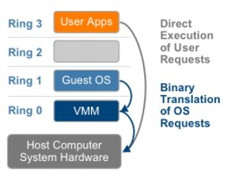
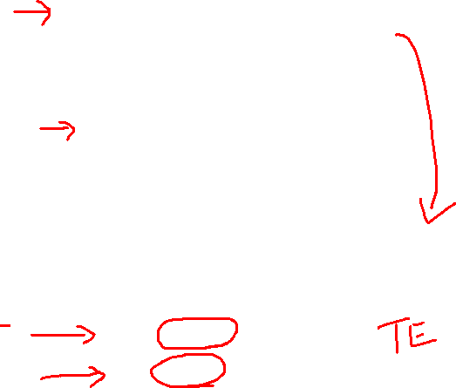
VMware's Solution
VMware resolved the challenge in 1998, developing binary translation techniques that allow the VMM to run in Ring 0 for isolation and performance, ​
The operating system was moved to a user level ring with greater privilege than applications in Ring 3 but less privilege than the virtual machine monitor in Ring 0. ​
While VMware’s full virtualization approach using binary translation is the de facto standard today the industry as a whole has not yet agreed on open standards to define and manage virtualization. ​
Each company developing virtualization solutions is free to interpret the technical challenges and develop solutions with varying strengths and weaknesses.​
Before
After
Notes:
VMware’s Solution
Key Points:
Binary Translation Techniques:
VMware developed binary translation techniques in 1998.
These techniques allow the Virtual Machine Monitor (VMM) to run in Ring 0, which is the most privileged level, for better isolation and performance.
System Architecture Changes:
Before: Traditional setup with User Apps, Direct Execution of User Requests, Host OS, and Host Computer Hardware layers.
After: User Apps directly interact with the VM Monitor, bypassing the Host OS layer, which then interacts with the Host Computer Hardware.
Privilege Levels:
The operating system was moved to a user level ring with greater privilege than applications in Ring 3 but less than the VMM in Ring 0.
Industry Standards:
While VMware’s full virtualization approach using binary translation is the de facto standard, the industry has not yet agreed on open standards for defining and managing virtualization. Each company develops its solutions with varying strengths and weaknesses.

Slide 20
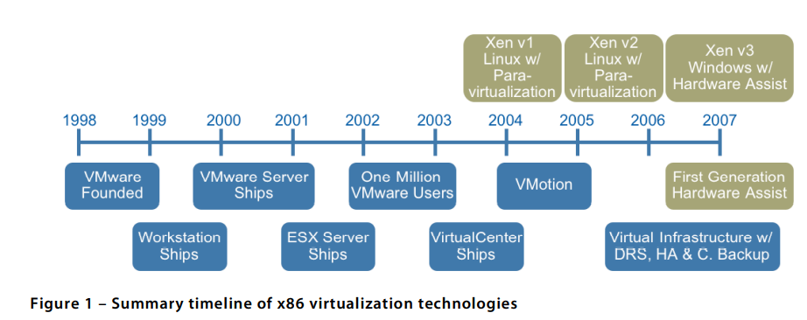
Virtualization Evolution
In 1998, VMware figured out how to virtualize the x86 platform, once thought to be impossible, and created the market for x86 virtualization.
The solution was a combination of binary translation and direct execution on the processor that allowed multiple guest OSes to run in full isolation on the same computer with readily affordable virtualization overhead
Currently, the most commonly used virtualization feature is hardware-assisted virtualization. Hardware-assisted virtualization is a feature built into modern CPUs that provides improved performance and security for virtualization compared to traditional software-based virtualization technologies.
Hardware-assisted virtualization is supported by Intel's VT-x and AMD's AMD-V technology and is used by many popular virtualization platforms, such as VMware, Hyper-V, and Oracle VirtualBox. This technology allows the virtualization software to run virtual machines with near-native performance, as the virtualization software is able to directly access and use the CPU's hardware-assisted virtualization features
Notes:
The evolution of virtualization has been a transformative journey, significantly impacting the way IT infrastructure is designed, deployed, and managed. Here's a brief overview of its development:
1. Early Beginnings (1960s - 1970s)
Mainframe Virtualization: Virtualization began in the 1960s with IBM's CP/CMS operating system, which allowed mainframe computers to be partitioned into multiple virtual machines (VMs). Each VM could run its own instance of an operating system, enabling more efficient use of the expensive hardware.
Time-Sharing Systems: The concept of time-sharing, where multiple users could access a single computer simultaneously, laid the groundwork for virtualization by allowing multiple processes to run concurrently.
2. Rise of x86 Virtualization (1990s - Early 2000s)
Hardware Virtualization on x86: The 1990s saw the introduction of x86 virtualization, allowing standard PC hardware to run multiple operating systems simultaneously. VMware, founded in 1998, was a key player in this era, introducing its VMware Workstation and later, VMware ESX Server.
Commercialization: With VMware's success, virtualization became more mainstream, moving from large, expensive mainframes to more affordable, widely-used x86 servers. This democratized access to virtualization, making it available to smaller enterprises.
3. Server Consolidation and Data Center Virtualization (2000s)
Server Consolidation: As virtualization matured, organizations began using it to consolidate servers, reducing the number of physical servers required and maximizing hardware utilization. This led to significant cost savings and increased flexibility in data center management.
Hypervisor Development: Hypervisors, the software that creates and manages VMs, evolved significantly during this period. Type 1 hypervisors (e.g., VMware ESXi, Microsoft Hyper-V, and Xen) became more robust and feature-rich, enabling more efficient and secure virtualization environments.
Adoption of Virtualization in Enterprise IT: By the mid-2000s, virtualization was widely adopted in enterprise IT environments, becoming a standard practice for deploying and managing servers.
4. Cloud Computing and Virtualization (2010s)
Cloud Revolution: Virtualization was a key enabler of cloud computing, allowing providers to offer scalable, on-demand computing resources over the internet. Infrastructure as a Service (IaaS) platforms like Amazon Web Services (AWS), Microsoft Azure, and Google Cloud heavily rely on virtualization technologies.
Containerization: Around this time, containerization, led by technologies like Docker, began to gain traction. Containers offer a more lightweight form of virtualization at the application level, allowing for faster deployment and better resource efficiency compared to traditional VMs.
Software-Defined Data Centers (SDDC): Virtualization extended beyond just compute resources to include storage and networking, leading to the concept of SDDC, where all infrastructure resources are virtualized and managed through software.
5. Virtualization in Modern IT (2020s and Beyond)
Hybrid and Multi-Cloud Environments: Modern IT environments increasingly rely on hybrid and multi-cloud strategies, where workloads are distributed across on-premises data centers and multiple cloud providers. Virtualization plays a critical role in managing these complex environments.
Edge Computing: As edge computing grows, virtualization is extending to the edge of the network, enabling more efficient resource use in environments like IoT, where computing needs to happen closer to the data source.
Advanced Virtualization Techniques: Technologies such as network function virtualization (NFV), GPU virtualization, and virtual desktop infrastructure (VDI) are becoming more common, expanding the use cases for virtualization.
Security and Compliance: As virtualization becomes more ubiquitous, there is a stronger focus on security and compliance, leading to the development of more secure hypervisors and virtualization platforms.
6. Future Trends
Serverless Computing: Building on virtualization and containerization, serverless computing is an emerging trend where the cloud provider dynamically manages the allocation of resources, abstracting away the underlying infrastructure.
AI and Machine Learning: Virtualization platforms are increasingly incorporating AI and machine learning to optimize resource allocation, enhance security, and automate management tasks.
Quantum Computing and Virtualization: As quantum computing evolves, there may be future developments in how virtualization adapts to new types of hardware and computational paradigms.
Summary
The evolution of virtualization has transitioned from its roots in mainframe computing to a foundational technology in modern IT. It has enabled more efficient use of hardware, driven the cloud computing revolution, and continues to evolve with emerging technologies such as containers, edge computing, and AI. As IT continues to grow in complexity, virtualization remains a critical tool for managing resources and delivering scalable, flexible, and secure computing environments.

Slide 21
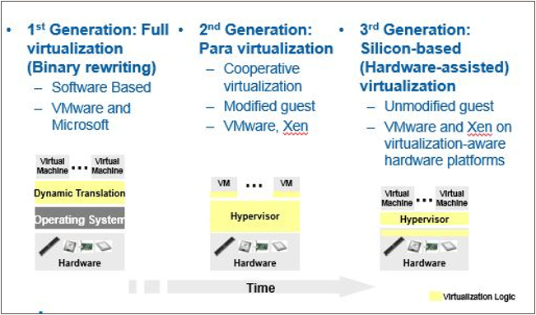

Introduction
Evolution
1st Generation: Full virtualization (Binary rewriting)​
Software Based​
VMware and Microsoft​
2nd Generation: Para virtualization​
Cooperative virtualization​
Modified guest​
VMware, Xen​
3rd Generation: Silicon-based (Hardware-assisted) virtualization​
Unmodified guest​
VMware and Xen on virtualization-aware hardware platforms​
Notes:
1st Generation: Full Virtualization (Binary Rewriting)
Technology: This method involves software-based virtualization where the virtual machine (VM) executes non-privileged instructions directly on the host CPU, but privileged instructions are trapped and emulated by the hypervisor.
Key Players: VMware and Microsoft are mentioned as major providers.
Characteristics: Full virtualization requires no modification of the guest operating system but can be less efficient due to the overhead of binary translation.
2nd Generation: Para-Virtualization
Technology: Para-virtualization involves modifying the guest operating system to be aware of the virtualization environment, allowing for more efficient interaction with the hypervisor.
Key Players: VMware and Xen are mentioned here.
Characteristics: This method is more efficient than full virtualization but requires changes to the guest OS, making it less flexible.
3rd Generation: Silicon-Based (Hardware-Assisted) Virtualization
Technology: This technique leverages hardware features, such as Intel VT-x or AMD-V, to assist in virtualization, allowing the execution of virtual machines without modifying the guest OS.
Key Players: Again, VMware and Xen are prominent in this generation.
Characteristics: It supports unmodified guests and offers improved performance by offloading some of the virtualization tasks to the hardware, reducing the overhead associated with software-only solutions.

Slide 22
Virtualization Approaches

Slide 23
Emulation
Emulation is the process where the virtualizing software mimics that portion of hardware, which is provided to the guest operating system in the virtual machine. The presented emulated hardware is independent of the underlying physical hardware.
Emulation provides VM portability and wide range of hardware compatibility, which means the possibility of executing any virtual machine on any hardware, as the guest operating system interacts only with the emulated hardware.
In an emulated environment, both the application and guest operating system in virtual machines run in the user mode of base operating system. In simple terms, the behavior of the hardware is produced by a software program.
Emulation process involves only those hardware components so that user or virtual machines does not understand the underlying environment.
Notes:
Emulation is a technique used in computing where one system mimics the functions of another system. This allows software or hardware designed for one environment to run in a different environment. Emulation typically involves translating instructions meant for one type of processor or system into instructions that another processor or system can understand and execute.
Key Points about Emulation:
Purpose: The primary purpose of emulation is to allow software or hardware designed for one platform to run on another platform that may have different hardware or software architecture. This is common in scenarios like running old video games on modern systems, or running applications designed for one operating system on another.
Performance: Emulation can be slow compared to running software natively, as the emulator has to translate each instruction in real-time. This translation process adds overhead, which can impact performance.
Examples:
Software Emulation: Running an application designed for Windows on a macOS system using an emulator like Wine.
Hardware Emulation: Using a virtual machine to emulate an entire computer system, such as running a Windows environment within a Linux system using virtualization software.
Virtualization vs. Emulation:
Virtualization generally refers to running multiple operating systems on the same hardware where the virtualized systems share resources with the host. Virtualization is more efficient than emulation as it uses the hardware directly, with little to no translation.
Emulation, on the other hand, fully mimics the hardware and software environment, which allows for greater compatibility but typically comes with a performance cost due to the need for instruction translation.
Use Cases:
Legacy Software: Running old applications or games that are no longer supported on modern hardware.
Cross-Platform Development: Developers can test software on different platforms without needing the original hardware.
Education: Understanding and experimenting with different computing architectures.
In summary, while emulation is a powerful tool for ensuring compatibility across different systems, it is generally slower and less efficient than virtualization due to the overhead of instruction translation.

Slide 24
Emulation
Only CPU & memory are sufficient for basic level of emulation. Typically, emulation is implemented using interpretation. The emulator component takes each and every instruction of user mode and translates to equivalent instruction suitable according to the underlying hardware. This process is also termed as interpretation.
This means that the guest OS remains completely unaware of the virtualization. Also, in interpretation, each and every instruction issued by a VM is trapped in the VMM and interpreted for execution in the hardware. Goes without saying that computationally it is a very expensive method. However, in some cases,, it is needed to use an interpretation technique. However, due to the huge disadvantage of performance, emulation using interpretation is hardly used in virtualization.

Slide 25
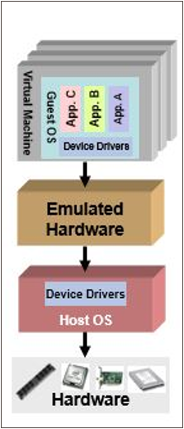
Binary Translation / Full Virtualization
In its basic form known as “full virtualization” the hypervisor provides a fully emulated machine in which an operating system can run. VMWare is a good example. ​
The biggest advantage to this approach is its flexibility: one could run a RISC-based OS as a guest on an Intel-based host. ​
While this is an obvious approach, there are significant performance problems in trying to emulate a complete set of hardware in software. ​
1st Generation offering of x86/x64 server virtualization ​.
Dynamic binary translation​.
The emulation layer talks to an operating system which talks to the computer hardware​.
The guest OS doesn't see that it is used in an emulated environment​.
Notes:
Binary Translation and Full Virtualization are related concepts in virtualization technology that enable a virtual machine (VM) to run an unmodified guest operating system on a host machine.
Binary Translation:
Definition: Binary translation is a technique used to execute instructions from a guest operating system that are incompatible with the host's hardware by translating them into compatible instructions at runtime. This is necessary because certain privileged instructions that the guest OS might attempt to execute could interfere with the host system or cause errors if run directly.
How It Works:
In binary translation, the hypervisor (or Virtual Machine Monitor, VMM) intercepts these privileged instructions and replaces them with equivalent sequences of instructions that are safe to run on the host hardware.
This translation happens dynamically during the execution of the guest OS, allowing the VM to run as if it has full control over the hardware, even though it’s being carefully managed by the hypervisor.
Full Virtualization:
Definition: Full virtualization is a virtualization technique that allows an unmodified guest operating system to run in a VM as if it were running directly on the physical hardware.
Role of Binary Translation: Full virtualization often relies on binary translation to handle instructions that cannot be directly executed by the host CPU due to privilege level issues. In full virtualization, the guest OS is unaware that it is running in a virtualized environment because the hypervisor ensures that all instructions are handled appropriately.
Examples:
Software-Based Full Virtualization: Earlier versions of VMware used binary translation as part of their full virtualization approach. The hypervisor would intercept and translate privileged instructions from the guest OS into safe instructions that could run on the host CPU.
Hardware-Assisted Virtualization: In modern systems, hardware features like Intel VT-x and AMD-V have reduced the need for binary translation by allowing the CPU to directly support multiple privilege levels and trap sensitive instructions more efficiently.
Advantages of Full Virtualization:
Compatibility: It allows running unmodified guest operating systems, meaning the OS doesn't need to be aware it's running in a virtual environment.
Isolation: Each VM is fully isolated from others, ensuring stability and security.
Ease of Use: No changes are required to the guest OS, making it easier to deploy and manage VMs.
Disadvantages of Binary Translation (in Software-Only Full Virtualization):
Performance Overhead: The translation process adds overhead, which can slow down execution compared to running the OS directly on hardware.
Complexity: Binary translation is a complex process, requiring sophisticated algorithms to ensure correct and efficient translation of instructions.
Transition to Hardware-Assisted Virtualization:
As CPUs evolved to include virtualization extensions (e.g., Intel VT-x, AMD-V), the need for binary translation diminished. These hardware features allow the CPU to handle privileged instructions natively in a virtualized environment, reducing the performance overhead and complexity associated with full virtualization.
In summary, binary translation is a key technique that enabled full virtualization in early virtualization technologies by allowing unmodified guest operating systems to run on a virtualized hardware environment. However, with the advent of hardware-assisted virtualization, the reliance on binary translation has decreased, leading to improved performance and efficiency.

Slide 26
Binary Translation / Full Virtualization - Pros
The emulation layer ​Isolates VMs from the host OS and from each other​.
Controls individual VM access to system resources, preventing an unstable VM from impacting system performance​.
Total VM portability.​
By emulating a consistent set of system hardware, VMs have the ability to transparently move between hosts with dissimilar hardware without any problems.​
It is possible to run an operating system that was developed for another architecture on your own architecture.​
A VM running on a Dell server can be relocated to a Hewlett-Packard server​.​
Notes:
Binary Translation and Full Virtualization have played a crucial role in enabling virtual machines to run unmodified operating systems on standard hardware. Here are some of the pros associated with these technologies:
Pros of Binary Translation:
Compatibility with Unmodified Guest OS:
Binary translation allows for running an unmodified guest operating system on the virtual machine, meaning no changes are required to the OS or its applications. This ensures broad compatibility with existing software.
Transparency:
The guest OS operates as though it is running directly on physical hardware, unaware that it is in a virtualized environment. This transparency simplifies deployment and management, as no special drivers or modifications are needed.
Flexibility:
Binary translation enables a wide range of operating systems to be virtualized, even those not initially designed to run in a virtualized environment. This flexibility makes it possible to consolidate different OS environments on the same physical server.
Isolation:
By intercepting and translating privileged instructions, binary translation helps maintain a clear separation between the guest OS and the host hardware, enhancing security and stability. Each VM is isolated from others, preventing interference.
Legacy Support:
For older hardware that doesn't support hardware-assisted virtualization (like Intel VT-x or AMD-V), binary translation provides a way to achieve full virtualization, making it possible to run virtualized environments on legacy systems.
Enhanced Security:
Since binary translation involves the hypervisor intercepting and managing privileged instructions, it adds an additional layer of security by controlling and verifying the execution of potentially harmful operations.
Pros of Full Virtualization:
Wide Adoption and Industry Support:
Full virtualization, especially in its early stages, became widely adopted and supported by major industry players like VMware and Microsoft. This broad support helped establish it as a standard for virtualization.
No Need for Guest OS Modifications:
Full virtualization does not require changes to the guest OS. This makes it easier to deploy and manage virtual machines, as there’s no need to modify or recompile the OS to be aware of the virtual environment.
Support for Multiple OS Types:
Full virtualization can support multiple types of guest operating systems on the same hardware, enabling environments where Linux, Windows, and other OSs run side by side on the same physical server.
Resource Utilization:
By allowing multiple VMs to run on a single physical machine, full virtualization improves hardware utilization. This leads to better resource efficiency, reducing the need for dedicated physical servers.
Ease of Migration:
Virtual machines created in a fully virtualized environment can often be easily migrated from one host to another, enabling better load balancing, disaster recovery, and maintenance without significant downtime.
Scalability:
Full virtualization makes it easier to scale infrastructure. New VMs can be created and deployed quickly, supporting dynamic workloads and growing infrastructure needs without the need for additional physical hardware.
Security and Isolation:
Full virtualization provides strong isolation between VMs, reducing the risk that a security breach in one VM could affect others. This isolation is critical in multi-tenant environments like cloud computing.
Transition to Hardware-Assisted Virtualization:
While binary translation and full virtualization offered numerous benefits, the introduction of hardware-assisted virtualization (Intel VT-x, AMD-V) improved these technologies by reducing the overhead of translation and providing better performance, while maintaining all the benefits of full virtualization.
In summary, binary translation and full virtualization have been pivotal in enabling the virtualization of a wide range of operating systems without requiring modifications. They offer compatibility, flexibility, isolation, and resource efficiency, making them essential technologies in the evolution of virtualization.

Slide 27
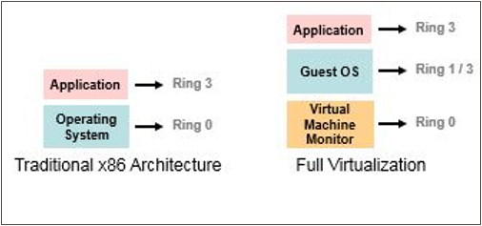
Binary Translation / Full Virtualization - Cons
Emulation has a cost associated.
Need to Trap & Emulate all instructions
Because Ring 0 is controlled by the host OS, VMs are forced to execute at Ring 1/3,
Resulting in VMM translating instructions.​
Notes:
While Binary Translation and Full Virtualization have been critical in the development of virtualization technology, they do come with some drawbacks. Here are the cons associated with these techniques:
Cons of Binary Translation:
Performance Overhead:
Binary translation involves dynamically intercepting and translating privileged instructions from the guest OS into instructions that can safely run on the host CPU. This process introduces a significant performance overhead, slowing down the execution of the guest operating system compared to running directly on hardware.
Complexity:
Implementing binary translation is complex. The hypervisor must be sophisticated enough to correctly and efficiently translate a wide range of CPU instructions, handle different OS behaviors, and manage various edge cases. This complexity can lead to bugs and stability issues.
Latency Issues:
The dynamic nature of binary translation can introduce latency, especially for tasks that involve frequent interactions with hardware or privileged instructions. This can impact the performance of applications running within the virtual machine.
Resource Consumption:
The process of binary translation consumes additional CPU and memory resources, reducing the amount of resources available for the guest OS and applications. This can be particularly problematic in environments with limited hardware resources.
Scalability Limitations:
Due to the overhead and resource consumption associated with binary translation, scaling a large number of virtual machines on a single physical host can be challenging. The efficiency of the system decreases as more VMs are added.
Compatibility Issues:
While binary translation aims to be transparent to the guest OS, certain low-level system functions or unique hardware features might not be fully supported or could behave unexpectedly, leading to compatibility issues with some software or drivers.
Cons of Full Virtualization:
Higher Resource Requirements:
Full virtualization, especially when using software-based binary translation, tends to require more CPU, memory, and storage resources compared to paravirtualization or hardware-assisted virtualization. This can limit the number of VMs that can be effectively run on a single host.
Lower Efficiency:
The need to intercept and emulate privileged instructions can reduce the overall efficiency of the system. The virtualized environment might not perform as well as a natively running operating system, especially for I/O-intensive tasks.
Increased Complexity in Management:
Managing a fully virtualized environment can be more complex, particularly when dealing with performance tuning, troubleshooting, and ensuring that the virtualization layer operates smoothly with various guest OS configurations.
Security Concerns:
While full virtualization provides good isolation, the added complexity of the hypervisor and binary translation process can introduce potential vulnerabilities. If the hypervisor has flaws, it could become a target for attacks, potentially compromising the security of all VMs on the host.
Dependence on Hypervisor Maturity:
The effectiveness of full virtualization depends heavily on the maturity and quality of the hypervisor. Early or less-developed hypervisors might struggle with stability, leading to potential downtime or issues with VM performance.
Challenges with Real-Time Applications:
Applications requiring real-time processing or low-latency responses may not perform well in a fully virtualized environment due to the inherent delays introduced by binary translation and the virtualization layer.
Shift to Hardware-Assisted Virtualization:
Many of these cons have been mitigated by the shift to hardware-assisted virtualization (e.g., Intel VT-x, AMD-V), which reduces the need for binary translation by allowing the CPU to handle privileged instructions more directly. This has significantly improved performance, reduced complexity, and enhanced the scalability of virtualized environments.
In summary, while binary translation and full virtualization have enabled broad compatibility and flexibility in virtualized environments, they come with performance, complexity, and resource-related drawbacks that have led to the development and adoption of more efficient hardware-assisted virtualization technologies.

Slide 28
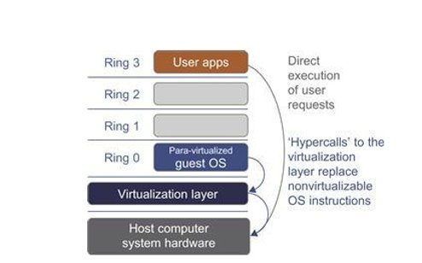
Para Virtualization
Paravirtualization,” found in the XenSource, open source Xen product, attempts to reconcile these two approaches. Instead of emulating hardware, paravirtualization uses slightly altered versions of the operating system which allows access to the hardware resources directly as managed by the hypervisor. ​
The Guest OS is modified and thus run kernel level operations at Ring 1 (or 3)​
the guest is fully aware of how to process privileged instructions​
thus, privileged instruction translation by the VMM is no longer necessary​
The guest operating system uses a specialized API to talk to the VMM and, in this way, execute the privileged instructions​
The VMM is responsible for handling the virtualization requests and putting them to the hardware​
Notes:
Para-Virtualization is a virtualization technique that requires the guest operating system to be aware that it is running in a virtualized environment. Unlike full virtualization, where the guest OS is unaware of the virtualization layer, para-virtualization involves modifying the guest OS so that it can communicate directly with the hypervisor, leading to more efficient operation.
Key Features of Para-Virtualization:
Modified Guest OS:
In para-virtualization, the guest operating system is modified to interact with the hypervisor more efficiently. These modifications are typically done at the kernel level, where the OS is made aware that it is running in a virtual environment and can therefore bypass certain operations that would normally require emulation.
Cooperative Virtualization:
The guest OS cooperates with the hypervisor by using a special API provided by the hypervisor. This API allows the guest OS to perform operations (such as memory management and I/O tasks) more efficiently, without the need for the hypervisor to intercept and translate privileged instructions.
Reduced Overhead:
Because the guest OS is aware of the virtual environment and can communicate directly with the hypervisor, para-virtualization reduces the overhead associated with full virtualization techniques like binary translation. This results in better performance, particularly for I/O-intensive operations.
Hypervisor Role:
The hypervisor in a para-virtualized environment plays a crucial role in managing the communication between the guest OS and the hardware. It provides the necessary interfaces and controls access to hardware resources, ensuring that multiple virtual machines can operate efficiently on the same physical host.
Pros of Para-Virtualization:
Improved Performance:
By allowing the guest OS to directly communicate with the hypervisor, para-virtualization reduces the overhead associated with intercepting and translating instructions, leading to better performance, especially for I/O-bound applications.
Efficient Resource Utilization:
The reduced overhead means that more resources are available for the guest OS and its applications. This allows for better resource utilization, making it possible to run more VMs on the same physical hardware compared to full virtualization.
Lower Latency:
Para-virtualization typically results in lower latency for certain operations, as the guest OS can directly access hardware resources through the hypervisor, bypassing the need for emulation.
Enhanced Scalability:
The efficiency of para-virtualization makes it easier to scale environments by running multiple VMs on a single host. This is particularly beneficial in data center and cloud environments where scalability is critical.
Cons of Para-Virtualization:
Requires Modified OS:
One of the main drawbacks of para-virtualization is that it requires modifications to the guest OS. Not all operating systems support these modifications, limiting the range of OSs that can be virtualized using this technique.
Compatibility Issues:
Since para-virtualization requires a specially modified OS, it may not be compatible with all software or drivers. This can limit the deployment options and require additional testing to ensure compatibility with existing applications.
Maintenance Complexity:
Maintaining and updating a para-virtualized environment can be more complex, as it involves ensuring that the modified OS remains compatible with the hypervisor and other components of the virtualized environment.
Limited Adoption:
With the advent of hardware-assisted virtualization technologies (e.g., Intel VT-x, AMD-V), the need for para-virtualization has decreased. Many organizations have shifted to using full virtualization with hardware assistance, which provides similar performance benefits without requiring OS modifications.
Examples of Para-Virtualization:
Xen: The Xen hypervisor is one of the most well-known examples of para-virtualization. It allows multiple operating systems to run on the same hardware by modifying the guest OS kernel to interact with the Xen hypervisor. In Xen, para-virtualization was particularly beneficial before the widespread availability of hardware-assisted virtualization.
VMware's Early Implementations: Some early versions of VMware also utilized para-virtualization techniques to improve performance, especially in environments where hardware-assisted virtualization was not available.
Use Cases:
High-Performance Computing: Environments that require maximum performance and low overhead, such as high-performance computing (HPC) or data centers, might benefit from para-virtualization.
Legacy Systems: Para-virtualization can be useful in environments where hardware does not support modern hardware-assisted virtualization features, and full virtualization would impose too much overhead.
Shift to Hardware-Assisted Virtualization:
The introduction of hardware-assisted virtualization technologies has reduced the reliance on para-virtualization. These technologies provide the benefits of full virtualization with performance levels close to para-virtualization, without the need for modifying the guest OS. As a result, para-virtualization has become less common in modern virtualized environments.
In summary, para-virtualization is a technique that improves performance and efficiency by modifying the guest OS to communicate directly with the hypervisor. While it offers significant benefits, especially in environments with limited resources, its reliance on a modified OS and the rise of hardware-assisted virtualization have limited its adoption in recent years.

Slide 29
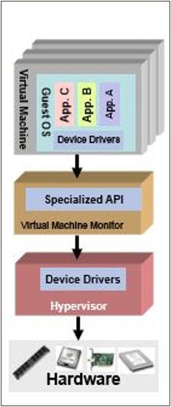
Para Virtualization
Today, VM guest operating systems are para virtualized using two different approaches:​
Recompiling the OS kernel​
Para virtualization drivers and APIs must reside in the guest operating system kernel.​
Modified operating system that includes this specific API, requiring a compiling operating systems to be virtualization aware.​
Some vendors (such as Novell) have embraced para virtualization and have provided para virtualized OS builds, while other vendors (such as Microsoft) have not.​
Installing para virtualized drivers​
In some operating systems it is not possible to use complete para virtualization, as it requires a specialized version of the operating system​
To ensure good performance in such environments, para virtualization can be applied for individual devices​
For example, the instructions generated by network boards or graphical interface cards can be modified before they leave the virtualized machine by using para virtualized drivers​
Notes:
Recompiling the OS Kernel: Para-virtualization drivers and APIs are embedded in the OS kernel, making the OS aware of virtualization. This requires modifying the OS to include specific APIs.
Installing Para-virtualized Drivers: In cases where full para-virtualization isn’t feasible, certain devices (e.g., network boards, graphical interface cards) can use para-virtualized drivers to optimize performance.

Slide 30
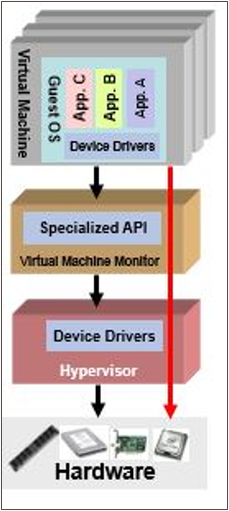
H/W Assisted Virtualization
This technique attempts to simplify virtualization because full or paravirtualization is complicated. ​
Intel and AMD add an additional mode called privilege mode level (some people call it Ring-1) to x86 processors. ​
Therefore, operating systems can still run at Ring 0 and the hypervisor can run at Ring -1. ​
All the privileged and sensitive instructions are trapped in the hypervisor automatically. ​
This technique removes the difficulty of implementing binary translation of full virtualization. It also lets the operating run without modification unlike para virtualization​
Notes:
Simplifying Virtualization:
Hardware-assisted virtualization aims to make the process of virtualization easier and more efficient, as full virtualization and paravirtualization can be challenging to implement.
Privilege Mode Level:
Intel and AMD introduced an additional privilege mode level, often referred to as "Ring -1," to their x86 processors. This level allows the hypervisor, a key component in virtualization, to run at a lower privilege level than the operating system, which typically operates at "Ring 0."
Operating System and Hypervisor Levels:
With this setup, the operating system can continue to run at "Ring 0" (its usual level), while the hypervisor runs at "Ring -1." This separation enhances security and efficiency.
Instruction Handling:
All privileged and sensitive instructions are automatically trapped by the hypervisor, ensuring that the virtualized environment operates securely and efficiently without interference from the operating system.
Advantages:
Hardware-assisted virtualization eliminates the need for complex binary translation, which is required in full virtualization. It also allows the operating system to run without modifications, unlike paravirtualization, which often requires changes to the OS.

Slide 31
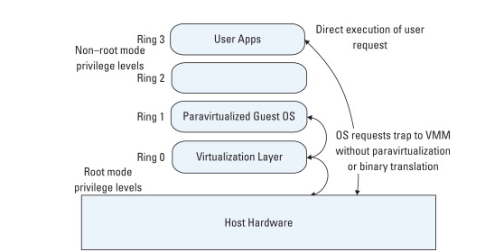
H/W Assisted Virtualization
Hardware-assisted virtualization. This term refers to a scenario in which the hardware provides architectural support for building a virtual machine manager able to run a guest operating system in complete isolation.
This technique was originally introduced in the IBM System/370. At present, examples of hardware-assisted virtualization are the extensions to the x86-64 bit architecture introduced with Intel VT (formerly known as Vanderpool) and AMD V (formerly known as Pacifica).
These extensions, which differ between the two vendors, are meant to reduce the performance penalties experienced by emulating x86 hardware with hypervisors. Before the introduction of hardware-assisted virtualization, software emulation of x86 hardware was significantly costly from the performance point of view.
The reason for this is that by design the x86 architecture did not meet the formal requirements introduced by Popek and Goldberg, and early products were using binary translation to trap some sensitive instructions and provide an emulated version. Products such as VMware Virtual Platform, introduced in 1999 by VMware, which pioneered the field of x86 virtualization, were based on this technique. After 2006, Intel and AMD introduced processor extensions, and a wide range of virtualization solutions took advantage of them: Kernel-based Virtual Machine (KVM), VirtualBox, Xen, VMware, Hyper-V, Sun xVM, Parallels, and others.
Notes:
Hardware-assisted virtualization is a technology where the hardware itself provides support to create and manage virtual machines, allowing them to run guest operating systems in complete isolation from one another. This approach enhances virtualization performance and security, making it more efficient than earlier software-based methods.
Historical Context and Development:
Origin: The concept of hardware-assisted virtualization was first introduced in the IBM System/370, a mainframe computer that laid the foundation for modern virtualization techniques.
Modern Implementations: Intel and AMD later introduced hardware-assisted virtualization extensions to the x86-64 architecture, known as Intel VT (formerly Vanderpool) and AMD-V (formerly Pacifica). These extensions were specifically designed to overcome the performance challenges of software-based virtualization.
Key Points:
Performance Enhancements:
Before hardware-assisted virtualization, emulating x86 hardware through software, such as using hypervisors, was highly resource-intensive. The x86 architecture did not originally meet the Popek and Goldberg virtualization requirements, necessitating complex techniques like binary translation to handle sensitive instructions.
Binary Translation:
Binary translation involves converting instructions from the guest operating system into a form that can be executed by the host system. While effective, this method incurred significant performance penalties.
Processor Extensions:
With the introduction of Intel VT and AMD-V around 2006, these performance challenges were largely mitigated. These extensions provide direct support for virtualization within the processor, reducing the overhead associated with trapping and emulating sensitive instructions.
Widespread Adoption:
The introduction of these processor extensions led to a broad adoption of hardware-assisted virtualization in various platforms and products. Some notable examples include KVM (Kernel-based Virtual Machine), VirtualBox, Xen, VMware, Hyper-V, Sun xVM, and Parallels.
Conclusion:
Hardware-assisted virtualization represents a significant advancement in the field of virtualization, enabling more efficient and secure management of virtual environments. By leveraging specific processor extensions, modern systems can achieve near-native performance in virtualized environments, making it a crucial technology in cloud computing, server consolidation, and other areas requiring robust virtualization capabilities.

Slide 32
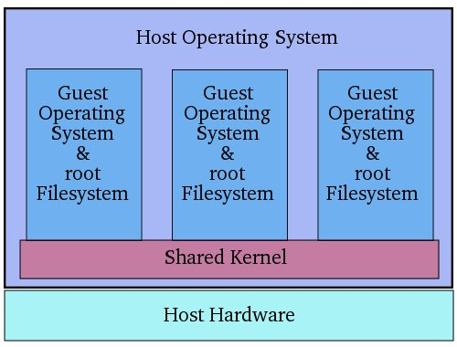
SKI Virtualization
Instead of using a hypervisor, it runs a separate version of the Linux kernel and sees the associated virtual machine as a user-space process on the physical host. This makes it easy to run multiple virtual machines on a single host. A device driver is used for communication between the main Linux kernel and the virtual machine. Processor support is required for virtualization ( Intel VT or AMD – v). A slightly modified QEMU process is used as the display and execution containers for the virtual machines. In many ways, kernel-level virtualization is a specialized form of server virtualization.
Examples: User – Mode Linux( UML ) and Kernel Virtual Machine( KVM ) , Docker, LXC
Note:
SKI means Single Kernel Image, is the basis for Container Technologies

Slide 33
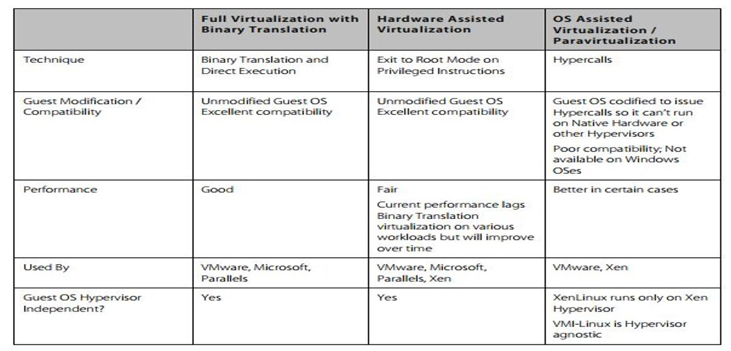
Virtualization Comparison

Slide 34
Virtualization Types

Slide 35
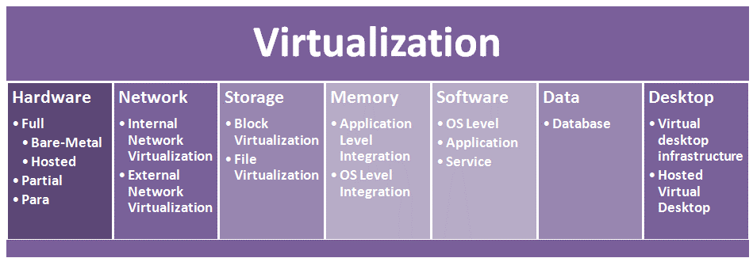
Virtualization

Slide 36
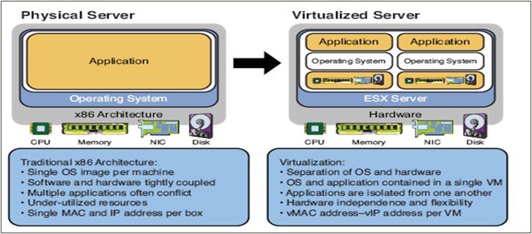
Server Virtualization
Abstracts the physical machine on which the software and operating system is running on and provides an illusion that the software is running on a virtual machine. ​
Enables Infrastructure as a service model. ​
A single physical machine can be used to create several VMs that can run several operating systems independently and simultaneously. VMs are stored as files, so restoring a failed system can be as simple as copying its file onto a new machine.​
The hypervisor software enables the creation of a virtual machine (VM) that emulates a physical computer by creating a separate OS environment that is logically isolated from the host server.​

Slide 37
Server Virtualization - Benefits
Partitioning​
Run multiple operating systems on one physical machine.​
Divide the physical system resources among virtual machines.​
One VM does not know the presence of the other.​
Management​
Failure of one VM does not affect other VMs.​
Management agents can be run on each VM separately to determine the individual performance of the VM and the applications that are running on the VM.​
Encapsulation​
The entire VM state can be saved in a file.​
Moving and copying VM information is as easy as copying files.​
Server virtualization is a key driving force in reducing the number of physical servers and hence the physical space, cooling, cabling, and capital expenses in any data center consolidation projects​
Notes:
1. Partitioning:
What it means: Server virtualization allows multiple operating systems to run on a single physical machine, each within its own virtual machine (VM).
Benefits:
The physical system’s resources, such as CPU and memory, are divided among different VMs, ensuring efficient resource usage.
VMs are isolated from each other, meaning one VM doesn’t know or interfere with the other, improving security and stability.
2. Management:
What it means: Virtualization simplifies the management of VMs, making system administration more efficient.
Benefits:
If one VM fails, it doesn't affect the other VMs running on the same physical server.
Management tools allow monitoring and controlling each VM independently, enabling better performance management and troubleshooting.
3. Encapsulation:
What it means: The state of a VM can be saved and stored as a file, encapsulating the VM’s entire environment.
Benefits:
Makes it easier to move or copy VMs between servers, as they are just files. This simplifies backups, disaster recovery, and migrations.
Virtualized Server vs. Physical Server (Diagram):
Physical Server: In traditional setups, a single physical server runs one application on one operating system. Each server is tightly coupled with hardware and has its own dedicated memory, CPU, and storage.
Virtualized Server: Virtualization decouples the operating system and applications from the physical hardware. Multiple applications run on multiple virtual machines, all sharing the same physical server’s resources (CPU, memory, etc.).
Key Insight:
Server Virtualization’s Impact:
Reduces the number of physical servers needed in a data center.
Lowers costs related to physical space, cooling, cabling, and capital expenditures, making it a key technology for data center consolidation.
In essence, server virtualization helps businesses achieve better resource utilization, easier management, and significant cost savings by enabling multiple virtual machines to run on fewer physical servers.

Slide 38
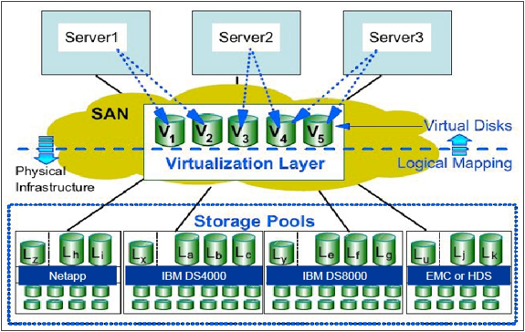
Storage Virtualization
Storage virtualization refers to providing a logical, abstracted view of physical storage devices. ​
It provides a way for many users or applications to access storage without being concerned with where or how that storage is physically located or managed. ​
It enables physical storage in an environment to be shared across multiple application servers, and physical devices behind the virtualization layer to be viewed and managed as if they were one large storage pool with no physical boundaries. ​
The storage virtualization hides the fact there are separate storage devices in an organization by making all the devices appear as one device. ​
Virtualization hides the complex process of where the data needs to be stored and bringing it back and presenting it to the user when it is required.​
​
Notes:
Storage virtualization is a technology that abstracts and pools physical storage resources across multiple devices and locations, presenting them as a single, unified storage system. It simplifies storage management, improves resource utilization, and enhances flexibility in data centers and enterprise environments. By decoupling storage hardware from the applications and users that access it, storage virtualization makes it easier to manage, scale, and optimize storage.
Key Components of Storage Virtualization
Physical Storage:
This refers to the underlying hardware, such as hard drives (HDDs), solid-state drives (SSDs), storage area networks (SANs), and network-attached storage (NAS). These resources are pooled and virtualized to create logical storage that is easier to manage.
Virtual Storage Pool:
Virtual storage pools combine multiple physical storage devices into one or more logical pools. Administrators can allocate storage from these pools to applications or users without worrying about the specifics of the underlying hardware.
Storage Controllers:
A storage virtualization controller (software or hardware) manages the abstraction layer between physical and virtual storage. It translates logical requests from applications into commands for the underlying physical storage systems.
Logical Volumes:
Virtual storage is typically presented as logical volumes or virtual drives, which can be dynamically resized and moved across physical devices without impacting the applications that access them.
Data Services:
Many storage virtualization solutions come with built-in data management features such as replication, deduplication, compression, and tiering, which improve efficiency, performance, and resilience.
Types of Storage Virtualization
Block-Level Storage Virtualization:
This type virtualizes storage at the block level, abstracting individual storage blocks from physical devices. It is commonly used in SANs where applications access storage as if it were a local hard drive, but the underlying blocks can be spread across multiple physical devices.
Example: VMware vSAN, IBM SAN Volume Controller (SVC).
File-Level Storage Virtualization:
In file-level virtualization, the system abstracts entire files and directories from the physical storage medium. This is common in NAS environments, where users access files via shared directories, but the actual file locations can be moved or distributed across different storage devices.
Example: NetApp's ONTAP, Windows DFS (Distributed File System).
Host-Based Virtualization:
Host-based storage virtualization occurs at the server level, where storage resources are virtualized on the server and presented to applications as logical storage volumes. This type is often implemented through hypervisors in virtual machine environments.
Example: VMware ESXi, Microsoft Hyper-V.
Array-Based Virtualization:
In this model, storage arrays virtualize resources internally, managing the abstraction of storage within the array itself. The array presents virtual storage pools to users and applications, with the array managing resource allocation and optimization.
Example: Dell EMC PowerMax, HPE 3PAR.
Network-Based Virtualization:
This approach virtualizes storage at the network level, typically in SANs, by using a network-based appliance that sits between storage systems and the servers accessing them. The appliance abstracts and manages multiple storage devices into one virtual pool.
Example: IBM SAN Volume Controller (SVC), Cisco MDS 9000.
Benefits of Storage Virtualization
Increased Resource Utilization:
Storage virtualization allows for better use of physical storage capacity by pooling underutilized resources across different devices. This reduces wasted space and optimizes resource allocation.
Simplified Management:
By abstracting the underlying physical hardware, storage virtualization simplifies storage management. Administrators can manage and allocate storage from a central interface, regardless of the diversity or complexity of the physical devices.
Scalability:
Storage virtualization makes it easy to scale storage resources by adding new devices to the virtual pool without disrupting existing operations. This is especially important in environments with rapidly growing data demands.
Improved Flexibility:
Virtualized storage environments offer greater flexibility in data management, allowing data to be moved, replicated, or reallocated across different physical devices without downtime or impact on applications.
Cost Efficiency:
Virtualization reduces the need for over-provisioning storage, leading to better cost efficiency. It also enables the use of lower-cost hardware alongside higher-performance devices in a single environment.
Enhanced Disaster Recovery and Data Protection:
Many storage virtualization solutions include features like replication, snapshots, and backup that improve data protection and disaster recovery. These features allow for faster recovery times in the event of hardware failures or data corruption.
High Availability:
Storage virtualization can provide redundancy and fault tolerance by replicating data across multiple physical devices. This ensures that data remains available even in the event of hardware failures.
Improved Performance:
Virtualized storage environments often include tiered storage, which automatically moves frequently accessed data to faster storage media (e.g., SSDs) while storing less critical data on slower, more cost-effective media (e.g., HDDs).
Challenges of Storage Virtualization
Performance Overhead:
The additional layer of abstraction in storage virtualization can introduce performance overhead, especially in highly virtualized environments with heavy I/O workloads. Optimization and fine-tuning are often necessary to mitigate this.
Complexity:
While storage virtualization simplifies many aspects of storage management, the underlying architecture can still be complex. Proper planning and management are essential to ensure performance, availability, and scalability.
Interoperability Issues:
Different storage vendors and solutions may have limited interoperability, making it challenging to integrate diverse storage systems into a single virtualized environment.
Cost:
The initial cost of deploying a storage virtualization solution, particularly for enterprise-grade systems, can be high, including hardware, software, and training investments.
Use Cases for Storage Virtualization
Data Center Storage Consolidation:
In large data centers, storage virtualization helps consolidate disparate storage systems, making it easier to manage, allocate, and optimize storage resources across multiple servers and applications.
Cloud Storage:
Cloud service providers use storage virtualization to create flexible, scalable storage environments that can dynamically allocate resources to multiple tenants.
Disaster Recovery:
Storage virtualization is ideal for disaster recovery setups, allowing seamless replication of data across different locations and simplifying failover processes.
Virtual Desktop Infrastructure (VDI):
VDI environments rely on storage virtualization to provide scalable, efficient storage for thousands of virtual desktops, ensuring fast access to data and minimizing bottlenecks.
Storage virtualization is an essential technology for modern IT infrastructure, enabling more efficient, scalable, and flexible storage management while improving cost efficiency and performance. It plays a crucial role in data centers, cloud environments, and enterprise IT systems, where managing vast amounts of data is critical.

Slide 39
Storage Virtualization - Benefits
Typically, the benefits are :- ​
Resource optimization : Storage virtualization enables you to obtain the storage space on an as-needed basis without any wastage, and it allows organizations to use existing storage assets more efficiently without the need to purchase additional assets.​
Cost of operation: Storage virtualization enables adding storage resources without regard to the application, and storage resources can be easily added to the pool by a drag-and-drop method using a management console by the operations people.​
Increased availability: Storage virtualization provisions the new storage resources in a minimal amount of time, improving the overall availability of resources​
Improved performance​
Examples of Storage Virtualization:
SAN ➔ Storage area Network
VDA ➔ Virtual Disk Array
Notes:
Storage virtualization abstracts physical storage resources across multiple storage devices, combining them into a single, unified pool that is centrally managed. This offers numerous advantages, particularly in large-scale data centers and enterprise IT environments. Here are the key benefits of storage virtualization:
1. Improved Resource Utilization
Storage virtualization enables better use of existing storage resources by combining fragmented or underutilized storage across different devices into a unified pool. This eliminates the need for excess capacity, allowing organizations to maximize storage without buying new hardware.
2. Simplified Storage Management
Centralized management of virtualized storage simplifies administrative tasks, allowing IT teams to manage multiple storage devices as one. This reduces the complexity of managing diverse storage types (e.g., SAN, NAS) and allows for more efficient storage provisioning, monitoring, and maintenance.
3. Scalability
Virtualized storage environments are highly scalable, making it easier to add more storage capacity as needed. New storage devices can be seamlessly integrated into the existing virtual pool without requiring significant reconfiguration or downtime.
4. Cost Savings
By improving storage utilization and allowing for the use of lower-cost storage devices alongside high-performance storage, virtualization reduces capital expenditures (CapEx). Additionally, streamlined management lowers operational expenditures (OpEx) by reducing the time and effort required for maintenance.
5. Better Data Protection and Disaster Recovery
Storage virtualization often includes built-in data protection features like snapshotting, cloning, and replication across multiple physical locations. This improves disaster recovery strategies, enabling faster and more efficient data recovery in the event of hardware failure or other data loss scenarios.
6. Improved Performance
Virtual storage systems often include features like automated tiering, which dynamically moves frequently accessed data to faster storage (e.g., SSDs) while less frequently accessed data is stored on slower, cheaper storage (e.g., HDDs). This boosts performance for critical applications.
7. Flexibility and Agility
Virtual storage environments provide greater flexibility by allowing organizations to mix and match different storage types (e.g., SAN, NAS, DAS) across vendors and models. This vendor-agnostic approach ensures that businesses can use the best available hardware without being locked into a single vendor solution.
8. High Availability
Storage virtualization typically includes built-in redundancy and failover mechanisms, ensuring that data remains accessible even if a specific storage device or path fails. This enhances uptime and availability, which is critical for mission-critical applications and services.
9. Automated Workflows
Automation tools can be integrated with storage virtualization platforms to automate routine tasks, such as capacity management, data migration, and backups. This reduces human error, ensures consistency, and frees up IT teams to focus on higher-value activities.
10. Easier Data Migration
Migrating data between storage systems, or from old hardware to new, is simplified with storage virtualization. Data can be moved without affecting applications or users, reducing downtime during migrations and upgrades.
11. Enhanced Data Sharing and Collaboration
Virtualized storage environments make it easier to share data across multiple systems and locations, supporting greater collaboration among users and applications. This is particularly useful in environments like cloud computing and distributed systems.
12. Energy Efficiency
By improving resource utilization and reducing the need for excess storage hardware, storage virtualization can lower power consumption and cooling requirements in data centers, contributing to greener and more sustainable IT operations.
13. Data Deduplication and Compression
Many storage virtualization platforms offer data deduplication and compression features, reducing the amount of physical storage needed by eliminating redundant data and optimizing space usage. This can lead to significant cost savings and improved storage efficiency.
14. Support for Hybrid and Multi-Cloud Environments
Virtualized storage allows businesses to manage data seamlessly across on-premises, hybrid, and multi-cloud environments. This flexibility is essential for modern cloud-based applications, where data needs to move easily between different locations and platforms.
Storage virtualization enhances efficiency, scalability, and cost-effectiveness in managing complex storage environments, making it indispensable for organizations with growing data needs.

Slide 40
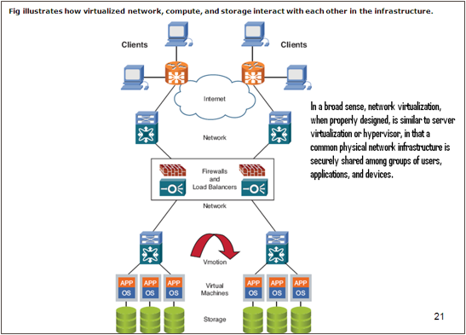
Network Virtualization
Network virtualization might be the most ambiguous virtualization of all virtualization types. Several types of network virtualization exist, as briefly described here:​
A VLAN is a simple example of network virtualization. VLANs allow logical segmentation of a LAN into several broadcast domains. VLANs are defined on a switch on a port-by-port basis. That is, you might choose to make ports 1–10 part of VLAN 1 and ports 11–20 part of VLAN 2. There’s no need for ports in the same VLAN to be contiguous. Because this is a logical segmentation and not physical, workstations connected to the ports do not have to be located together, and users on different floors in a building or different buildings can be connected together to form a LAN.​
Virtual Routing and Forwarding (VRF), commonly used in Multi-Protocol Label Switching (MPLS) networks, allows multiple instances of a routing table to coexist within the same router at the same time.​
Examples
VLAN ➔ Virtual Local Area Network
SDN ➔ S/W Defined Network
NFV ➔ Network Function Virtualization
Notes:
Network virtualization is the process of combining hardware and software network resources and functionality into a single, software-based administrative entity, enabling more efficient network management, resource allocation, and scalability. It abstracts physical network infrastructure (e.g., routers, switches, network cables) to create virtual networks that can run independently from the underlying hardware, enabling flexibility and better utilization of network resources.
Key Components of Network Virtualization
Virtual Networks:
Virtual Local Area Networks (VLANs): VLANs allow network administrators to partition physical networks into multiple logical networks, enabling different groups or services to share the same physical infrastructure while remaining isolated from one another.
Virtual Private Networks (VPNs): VPNs allow users to create a secure and encrypted connection over a public network (like the Internet), enabling remote access to private networks.
Overlay Networks: Virtual networks are often implemented as overlays on top of physical infrastructure, where packets are encapsulated and routed through tunnels (e.g., VXLAN, GRE) to create isolated virtual connections across shared physical hardware.
Network Function Virtualization (NFV):
NFV abstracts traditional network services such as firewalls, load balancers, routers, and intrusion detection systems (IDS) from dedicated hardware appliances and implements them as virtualized software services.
NFV reduces reliance on specialized hardware, offering greater flexibility and scalability, as virtualized network functions (VNFs) can be deployed and managed dynamically based on network demands.
Software-Defined Networking (SDN):
SDN separates the control plane (which makes decisions about where traffic should be sent) from the data plane (which actually forwards traffic). This decoupling allows for centralized management and control of the entire network through a software-based controller.
The SDN controller dynamically configures and manages network devices (switches, routers) based on policies, enabling efficient traffic routing, resource allocation, and improved network agility.
Virtual Network Interfaces:
Virtual network interfaces (vNICs) allow multiple virtual machines or containers on the same physical host to communicate with each other and external networks as though they each have their own dedicated network interface.
Virtual switches: Software-based switches (e.g., Open vSwitch) allow traffic to be routed between different vNICs and virtual networks, providing functionality similar to traditional hardware switches.
Types of Network Virtualization
Internal Network Virtualization:
Involves virtualizing network components within a single physical machine or data center. This typically means creating virtual switches, routers, and network interfaces to allow virtual machines, containers, or applications to communicate.
Common in cloud environments where multiple VMs or containers are hosted on a single physical server, and virtualized network components handle communication between them.
External Network Virtualization:
Combines or splits physical network resources into virtual entities that span across multiple physical locations, enabling connectivity across a broad set of physical hardware and devices.
External network virtualization is often used to interconnect different data centers, remote offices, or cloud environments, allowing them to operate as a unified network.
Benefits of Network Virtualization
Resource Optimization:
Network virtualization improves resource utilization by allowing multiple virtual networks to share the same physical infrastructure without interference, reducing the need for dedicated network hardware.
Flexibility and Scalability:
Virtualized networks can be quickly and easily reconfigured, expanded, or moved without changing the underlying physical infrastructure. This flexibility is essential for dynamic environments like cloud computing and data centers.
Improved Network Management:
Centralized control through SDN and NFV allows for more efficient management, monitoring, and automation of network policies and services. This reduces manual configuration and lowers operational costs.
Isolation and Security:
Virtual networks allow for complete isolation of traffic between different networks, improving security. Sensitive data can be confined within isolated virtual networks, preventing unauthorized access.
Cost Savings:
By reducing reliance on specialized network hardware and enabling better utilization of existing resources, organizations can lower capital and operational expenditures.
Use Cases of Network Virtualization
Cloud Computing:
Network virtualization is a key enabler of cloud computing environments like AWS, Google Cloud, and Microsoft Azure, where multiple tenants share the same physical infrastructure. Virtual networks isolate tenant traffic and provide secure, scalable connectivity across cloud instances.
Data Centers:
In modern data centers, network virtualization helps manage complex infrastructure, enabling efficient traffic flow between virtual machines, servers, and storage. This is crucial for high-availability, high-performance computing, and large-scale distributed applications.
Telecommunications:
Telecom providers leverage NFV and SDN to virtualize network functions, reducing the need for specialized hardware and enabling rapid deployment of new services, such as 5G networks, with improved flexibility and scalability.
Enterprise Networks:
Large organizations can use network virtualization to create isolated virtual networks for different departments, subsidiaries, or clients. This improves security and resource management while enabling streamlined network operations.
Challenges of Network Virtualization
Complexity:
Virtualized networks can introduce additional layers of complexity, requiring skilled personnel and advanced tools to design, implement, and maintain. Managing both virtual and physical infrastructure simultaneously can be challenging.
Performance Overhead:
Network virtualization may introduce performance overhead due to the additional abstraction layers and processing required to manage virtual networks. Proper configuration and optimization are essential to minimize latency and bottlenecks.
Security Risks:
Virtual networks introduce new attack surfaces. If not properly isolated and secured, they can become vulnerable to attacks, particularly in shared environments like the cloud. Network policies and security mechanisms must be carefully managed.
Interoperability:
Compatibility between different virtualization solutions, vendors, and legacy infrastructure can be an issue, especially in large organizations or multi-cloud environments where different networking technologies must work together.
Popular Technologies for Network Virtualization
OpenStack Neutron: Provides network-as-a-service (NaaS) for OpenStack cloud environments, enabling the creation of virtual networks, routers, and other network services for cloud tenants.
VMware NSX: A leading solution for network virtualization, NSX allows for the creation of virtual networks that are decoupled from physical hardware. It integrates with SDN and provides network services like load balancing, firewalls, and VPNs.
Cisco ACI (Application Centric Infrastructure): Cisco's SDN solution provides centralized network management and automation, enabling virtual network overlays, dynamic traffic routing, and policy-driven network control.
Open vSwitch (OVS): An open-source virtual switch used in virtualized environments for interconnecting virtual machines and containers within a hypervisor, such as KVM, and for supporting SDN.
Microsoft Hyper-V Network Virtualization (HNV): Part of Microsoft's cloud and virtualization platform, HNV provides network isolation and multi-tenant virtual networking, typically used in data center environments.
Network virtualization is revolutionizing how organizations manage, scale, and secure their networks, making it an essential technology for cloud computing, telecommunications, and enterprise IT environments.
4o

Slide 41
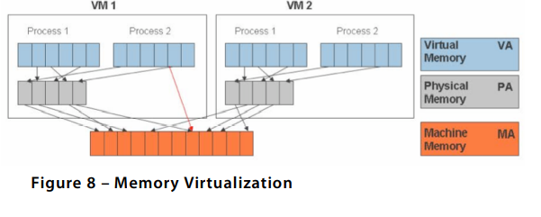
Memory Virtualization
Beyond CPU virtualization, the next critical component is memory virtualization.
This involves sharing the physical system memory and dynamically allocating it to virtual machines.
Virtual machine memory virtualization is very similar to the virtual memory support provided by modern operating systems.
Applications see a contiguous address space that is not necessarily tied to the underlying physical memory in the system.
The operating system keeps mappings of virtual page numbers to physical page numbers stored in page tables. All modern x86 CPUs include a memory management unit (MMU) and a translation lookaside buffer (TLB) to optimize virtual memory performance

Slide 42
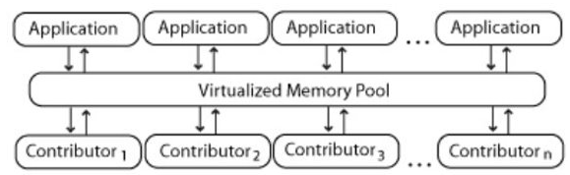
Memory Virtualization
It introduces a way to decouple memory from the server to provide a shared, distributed or networked function. It enhances performance by providing greater memory capacity without any addition to the main memory. That’s why a portion of the disk drive serves as an extension of the main memory.​
Application level integration – Applications running on connected computers directly connect to the memory​
pool through an API or the file system.​
Operating System Level Integration – The operating system first connects to the memory pool, and makes​
that pooled memory available to applications.
Notes:
Memory virtualization is a technology that abstracts and manages the physical memory of a computer, making it appear as a contiguous and large block of memory to applications and operating systems, even if the actual physical memory is fragmented or limited. It is a key feature in modern operating systems and hypervisors, allowing multiple processes or virtual machines (VMs) to efficiently share and use memory resources. Memory virtualization enhances system flexibility, isolation, and security.
Key Concepts of Memory Virtualization
Virtual Memory:
Virtual memory is a memory management technique where an operating system provides each process with the illusion of having a large, contiguous block of memory. The actual physical memory can be smaller and fragmented, but the OS manages this through paging or segmentation.
This enables applications to use more memory than is physically available by temporarily swapping inactive portions of memory to disk, typically called a page file or swap space.
Benefits:
Processes are isolated from one another, enhancing security.
Memory usage is optimized, allowing efficient multitasking.
Large applications can run even on systems with limited physical memory.
Paging:
Paging is a technique used to divide virtual memory into fixed-size blocks called pages. These pages are mapped to physical memory frames, which may not be contiguous.
When a program requests memory that isn't in physical memory (due to space constraints), the system will use page swapping or paging to move data between physical memory and storage (e.g., hard disk or SSD).
If a process attempts to access data not currently in physical memory, it results in a page fault, which triggers the OS to retrieve the data from storage and load it into RAM.
Segmentation:
Segmentation divides memory into variable-sized blocks called segments, each representing a logical division of a program (e.g., code, data, and stack segments).
While less common than paging, segmentation is useful in cases where distinct regions of memory need to be protected or isolated, especially in early memory management models.
Memory Mapping:
This involves associating virtual memory addresses with physical memory addresses. A memory management unit (MMU) handles the translation of virtual addresses to physical addresses on modern CPUs.
Memory mapping enables various features like shared memory between processes, faster data access by loading files directly into memory (via memory-mapped files), and memory isolation between applications.
Memory Virtualization in Virtualization Platforms
Hypervisor Memory Virtualization:
In virtualized environments, a hypervisor virtualizes memory so that each virtual machine (VM) thinks it has its own dedicated memory. The hypervisor manages the underlying physical memory and allocates it to VMs as needed.
Ballooning: A technique used by hypervisors (e.g., VMware, KVM) to reclaim memory from a VM that has been allocated more than it needs. It dynamically adjusts memory allocation across VMs based on demand.
Overcommitment: Hypervisors can allocate more virtual memory than the physical memory available on the host. This is possible because not all VMs use their maximum allocated memory simultaneously.
Transparent Page Sharing (TPS):
In virtualized environments, TPS allows the hypervisor to identify identical memory pages used by multiple VMs and store only a single copy of that page in physical memory. This reduces memory overhead, especially in scenarios where multiple VMs run identical operating systems or applications.
Memory Virtualization Techniques
Swapping:
When physical memory runs low, portions of inactive memory (virtual pages) are written to disk, freeing up space for active processes. When needed again, the data is loaded back into memory from the swap space.
Demand Paging:
Only the necessary pages of a program are loaded into physical memory, rather than loading the entire program at once. This improves memory efficiency by reducing the amount of memory required for active processes.
Memory Deduplication:
The system identifies duplicate copies of memory pages (often across different applications or VMs) and consolidates them into a single shared page to reduce memory consumption. This is commonly used in virtualized environments.
Benefits of Memory Virtualization
Improved Resource Utilization: Memory virtualization allows for efficient use of available memory, reducing wastage and enabling more applications or VMs to run on the same hardware.
Isolation and Security: Each process or VM operates in its own isolated memory space, protecting it from interference from other processes or VMs.
Flexibility and Scalability: Applications and VMs can use more memory than physically available through swapping or overcommitment, enhancing scalability.
Fault Tolerance: Memory virtualization can help mitigate the impact of memory faults by relocating pages and isolating problems.
Challenges of Memory Virtualization
Performance Overhead: Frequent swapping or paging can lead to performance degradation, particularly if data is constantly being moved between physical memory and disk.
Complexity: Managing virtualized memory environments, especially in large-scale data centers or cloud infrastructure, can be complex and require sophisticated tools and monitoring.
Memory Fragmentation: Over time, memory fragmentation can reduce the efficiency of memory allocation, requiring additional mechanisms for defragmentation or memory compaction.
Memory virtualization is essential in modern computing, providing flexibility, efficiency, and isolation in both traditional operating systems and cloud/virtualized environments.

Slide 43
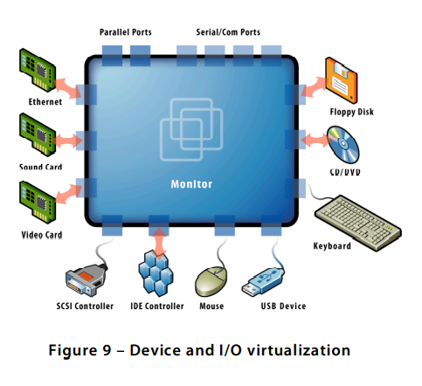
Device Virtualization
It provides the work convenience and security.
As one can access remotely, you are able to work from any location and on any PC. It provides a lot of flexibility for employees to work from home or on the go.
It also protects confidential data from being lost or stolen by keeping it safe on central servers.
​This involves managing the routing of I/O requests between virtual devices and the shared physical hardware.
Notes:
Device virtualization is a technology that allows physical hardware devices to be abstracted and emulated in a virtual environment, enabling them to be shared, partitioned, or isolated for use by multiple users or applications. It can refer to virtualizing various types of hardware, such as storage devices, network interfaces, or entire machines (e.g., servers, desktops). Here are the main types and uses of device virtualization:
1. Storage Virtualization:
Combines multiple physical storage devices into a single, unified virtual storage pool. This simplifies storage management and increases efficiency by allowing users to access storage resources without needing to know the underlying physical hardware.
Example: SAN (Storage Area Network) virtualization.
2. Network Virtualization:
Abstracts networking hardware (such as switches, routers, and network interfaces) to allow the creation of virtual networks. This allows network resources to be provisioned and managed more efficiently.
Example: SDN (Software-Defined Networking), VLANs (Virtual Local Area Networks).
3. Desktop Virtualization:
Allows virtual machines (VMs) running desktop operating systems to be hosted on centralized servers, enabling users to access their desktops remotely.
Example: VDI (Virtual Desktop Infrastructure), where a user’s desktop environment is virtualized.
4. Server Virtualization:
Partitions a physical server into multiple virtual machines, each of which can run its own operating system and applications independently.
Example: Hypervisors like VMware, KVM, or Microsoft Hyper-V.
5. I/O Virtualization:
Virtualizes input/output (I/O) devices, such as network cards or GPUs, allowing them to be shared between multiple virtual machines or applications. This is particularly useful in cloud computing and high-performance computing (HPC) environments.
Example: SR-IOV (Single Root I/O Virtualization), which enables a single physical device to appear as multiple virtual devices.
6. Peripheral Virtualization:
Allows virtual machines to access physical peripherals like USB devices, printers, or sound cards. This is useful in cases where VMs need to interact with specific hardware devices that are not directly connected to the host system.
Example: USB redirection in virtual desktop setups.
Benefits of Device Virtualization:
Resource Efficiency: Increases utilization of hardware by enabling multiple virtual devices to share the same physical resources.
Cost Savings: Reduces the need for additional physical hardware by using virtualized resources.
Flexibility and Scalability: Enables easier provisioning and scaling of devices and services.
Isolation and Security: Virtual devices are often isolated from one another, enhancing security.
Challenges:
Performance Overhead: Virtualization can introduce additional latency or performance bottlenecks compared to using physical hardware directly.
Complexity: Managing virtualized environments can be more complex, especially when dealing with large-scale virtual infrastructure.
Device virtualization is widely used in cloud computing, data centers, and enterprise environments, where resource optimization and flexibility are critical.
4o

Slide 44
Virtualization Advantages
Instant provisioning - fast scalability
Live Migration is possible
Load balancing and consolidation in a Data Center is possible.
Low downtime for maintenance
Virtual hardware supports legacy operating systems efficiently
Security and fault isolation

Slide 45
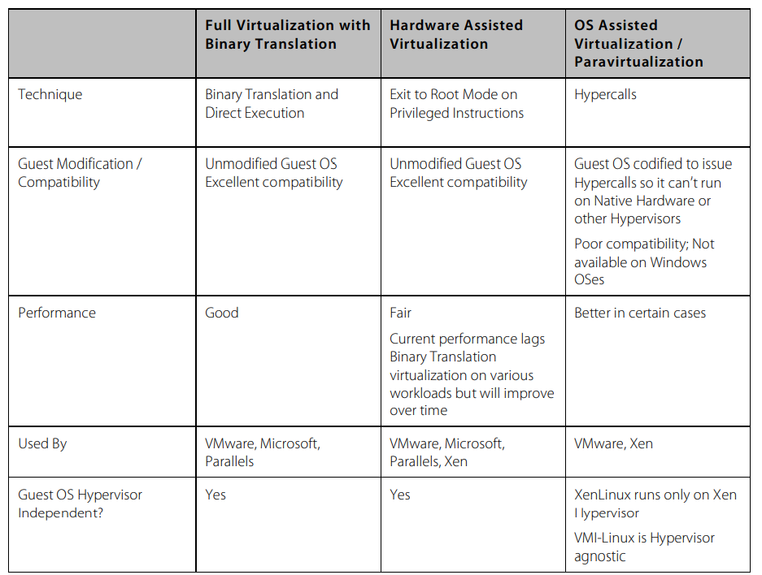
Virtualization Summary

Slide 46
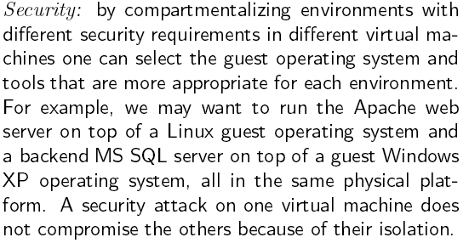
Virtualization Advantages

Slide 47
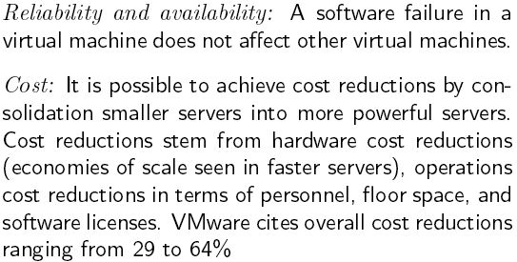
Virtualization Advantages

Slide 48
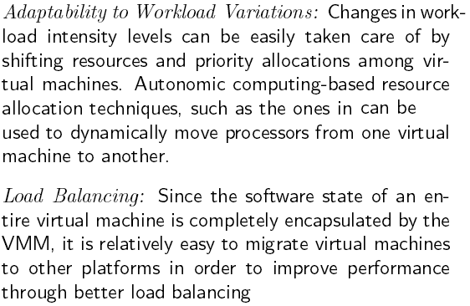
Virtualization Advantages

Slide 49
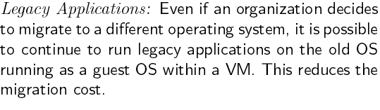
Virtualization Advantages
Notes:
Advantages of Virtualization:
Resource Optimization:
Virtualization maximizes the use of hardware resources by allowing multiple virtual machines (VMs) to run on a single physical server, reducing underutilization and ensuring that hardware investments are fully leveraged.
Cost Savings:
By consolidating multiple servers into fewer physical machines, organizations can reduce costs associated with hardware, power, cooling, and space. Virtualization also reduces the need for additional physical servers, lowering capital expenditures.
Scalability and Flexibility:
Virtualization enables the easy creation, deployment, and management of virtual machines, allowing organizations to scale their IT resources up or down quickly in response to changing needs. It also supports running different operating systems and applications on the same hardware.
Disaster Recovery:
Virtualization simplifies disaster recovery by allowing virtual machines to be easily backed up, replicated, and restored. Virtualization platforms often include features like automated failover, live migration, and snapshots, enhancing business continuity.
Improved Testing and Development:
Virtual environments provide isolated and easily reproducible test environments, allowing developers to test applications on multiple operating systems and configurations without the need for additional physical hardware.
Enhanced Security and Isolation:
Virtualization provides strong isolation between virtual machines, reducing the risk of security breaches spreading between systems. This isolation also allows for the safe testing of potentially harmful applications or code.
Simplified Management:
Centralized management tools for virtualized environments make it easier to monitor, manage, and maintain IT infrastructure. This includes automated deployment, load balancing, and resource allocation, which reduce the administrative burden.
Energy Efficiency:
By reducing the number of physical servers needed, virtualization lowers energy consumption for power and cooling, contributing to a greener and more environmentally friendly IT infrastructure.
Live Migration:
Virtualization enables the live migration of VMs between physical hosts without downtime, facilitating maintenance, load balancing, and resource optimization without impacting users.
Support for Legacy Systems:
Virtualization allows older operating systems and applications to run on modern hardware, extending the life of legacy systems and reducing the need for expensive upgrades or replacements.
In summary, virtualization offers significant advantages, including optimized resource use, cost savings, scalability, enhanced security, and simplified management. These benefits make virtualization a critical technology in modern IT infrastructure.

Slide 50
Points to Note
Software licensing
One of the most significant virtualization-related issues to be aware of is software licensing. Virtualization makes it easy to create new servers, but each VM requires its own separate software license. Organizations using expensive licensed applications could end up paying large amounts in license fees if they do not control their server sprawl.
IT training
IT staff used to dealing with physical systems will need a certain amount of training in virtualization. Such training is essential to enable the staff to debug and troubleshoot issues in the virtual environment, to secure and manage VMs, and to effectively plan for capacity.
Hardware investment
Server virtualization is most effective when powerful physical machines are used to host several VMs. This means that organizations that have existing not-so-powerful hardware might still need to make upfront investments in acquiring new physical servers to harvest the benefits of virtualization.
Notes:
Key Considerations for Virtualization:
Software Licensing: Virtualization can increase costs due to the need for separate licenses for each virtual machine (VM). Without careful management, organizations may face significant expenses from server sprawl.
IT Training: Staff familiar with physical systems require training to manage, secure, and troubleshoot virtual environments effectively. Proper training is crucial for capacity planning and maintaining a secure and efficient virtual infrastructure.
Hardware Investment: To maximize the benefits of server virtualization, organizations may need to invest in powerful physical machines. Existing less powerful hardware may not be sufficient to host multiple VMs effectively.

Slide 51
Application of Virtualization
Today, virtualization can apply to a range of system layers, including hardware-level virtualization, operating system-level virtualization, and high-level language virtual machines.
Maximize resources — Virtualization can reduce the number of physical systems you need to acquire, and you can get more value out of the servers. Most traditionally built systems are underutilized. Virtualization allows maximum use of the hardware investment.
Multiple systems — With virtualization, you can also run multiple types of applications and even run different OS for those applications on the same physical hardware.
IT budget integration — When you use virtualization, management, administration and all the attendant requirements of managing your own infrastructure remain a direct cost of your IT operation.
Notes:
Virtualization Across System Layers:
Versatility: Virtualization spans various system layers, including hardware-level, OS-level, and high-level language virtual machines, allowing for diverse applications.
Resource Optimization: It maximizes hardware utilization by reducing the number of physical systems needed and ensuring that servers are fully leveraged, addressing the common issue of underutilization in traditional setups.
Diverse Workloads: Virtualization enables running multiple applications and different operating systems on the same physical hardware, offering flexibility and efficiency in managing diverse workloads.
Cost Management: While virtualization optimizes resources, it still involves direct IT costs related to management, administration, and maintaining the infrastructure, which must be integrated into the overall IT budget.

Slide 52
Technology Trends
Virtualization is Key to Exploiting Trends
Allows most efficient use of the compute resources
Few apps take advantage of 16+ CPUs and huge memory as well as virtualization
Virtualization layer worries about NUMA, not apps
Maximize performance per watt across all servers
Run VMs on minimal # of servers, shutting off the others
Automated, live migration critical:
Provide performance guarantees for dynamic workloads
Balance load to minimize number of active servers
Stateless, Run-anywhere Capabilities
Shared network and storage allows flexible mappings
Enables additional availability guarantees
Notes:
Virtualization is Essential for Maximizing Compute Resources:
Efficiency: Virtualization optimizes the use of compute resources, especially when few applications can fully utilize multiple CPUs and large memory capacities.
NUMA Management: The virtualization layer handles Non-Uniform Memory Access (NUMA) complexities, freeing applications from this concern.
Energy Efficiency: It maximizes performance per watt by running virtual machines (VMs) on the minimum number of servers and shutting down unused ones.
Automated Live Migration: This feature is crucial for providing performance guarantees for dynamic workloads and balancing the load to minimize the number of active servers.
Flexibility and Availability: Stateless, run-anywhere capabilities are supported by shared network and storage, allowing flexible resource mapping and enhancing availability guarantees.

Slide 53

Q & A……..

Slide 54
Credits
Hwang, Kai; Dongarra, Jack; Fox, Geoffrey C.. Distributed and Cloud Computing: From Parallel Processing to the Internet of Things (Kindle Locations 3532-3533). Elsevier Science. Kindle Edition.

